Slide 1
Port Cities
Between Global Networks
and Local Transformations
Carola Hein, Tino Mager
Lecture 4: Sail Ships and Port Cities
GAHTC ©2021
Notes:
Welcome to Lecture 4 of Port Cities between global networks and local transformations. My name is Carola Hein and this lecture focuses on the age of sail and the development of port cities during that period.
Image:
Johannes Vingboons: View of Havana (1665) public domain
Image source:
https://commons.wikimedia.org/wiki/File:AMH-6757-NA_View_of_Havana.jpg

Slide 2
Port Cities
Between Global Networks
and Local Transformations
Carola Hein, Tino Mager
Lecture 4: Sail Ships and Port Cities
GAHTC ©2021
Notes:
Lecture Abstract:
With the discovery of America and the development of the Atlantic trade, new sea connections were created. Numerous cities notably in the Eastern Mediterranean lost their trade and decayed. Meanwhile others emerged. Notably port cities on the Atlantic side (e.g. Lisbon, Cadiz) experienced an upswing. The establishment of colonies and the construction of major trade hubs led to the creation of cities such as Havana and many ports in Latin America. With the ships came diseases, new cultures and religions, as well as architectural and urban planning concepts that were implemented through the Laws of the Indies (issued by the Spanish Crown for its American and Filipino possessions). The Laws of the Indies specified the form of urban plazas, the location and design of churches and many more buildings. These are a great example of the transfer of architectural and planning ideas through maritime networks.
Image:
Johannes Vingboons: View of Havana (1665) public domain
Image source:
https://commons.wikimedia.org/wiki/File:AMH-6757-NA_View_of_Havana.jpg

Slide 3
Port Cities
between global networks
and local transformations
Carola Hein, Tino Mager
Lecture 4: Sail ships and port cities
Part One: Europe
Part Two: Caribbean
Part Three: North America
Part Four: Asia
GAHTC ©2019.
Notes:
In this lecture we will look at architecture and urban planning related to maritime networks and port city development in Europe, the Caribbean, North America and Asia

Slide 4
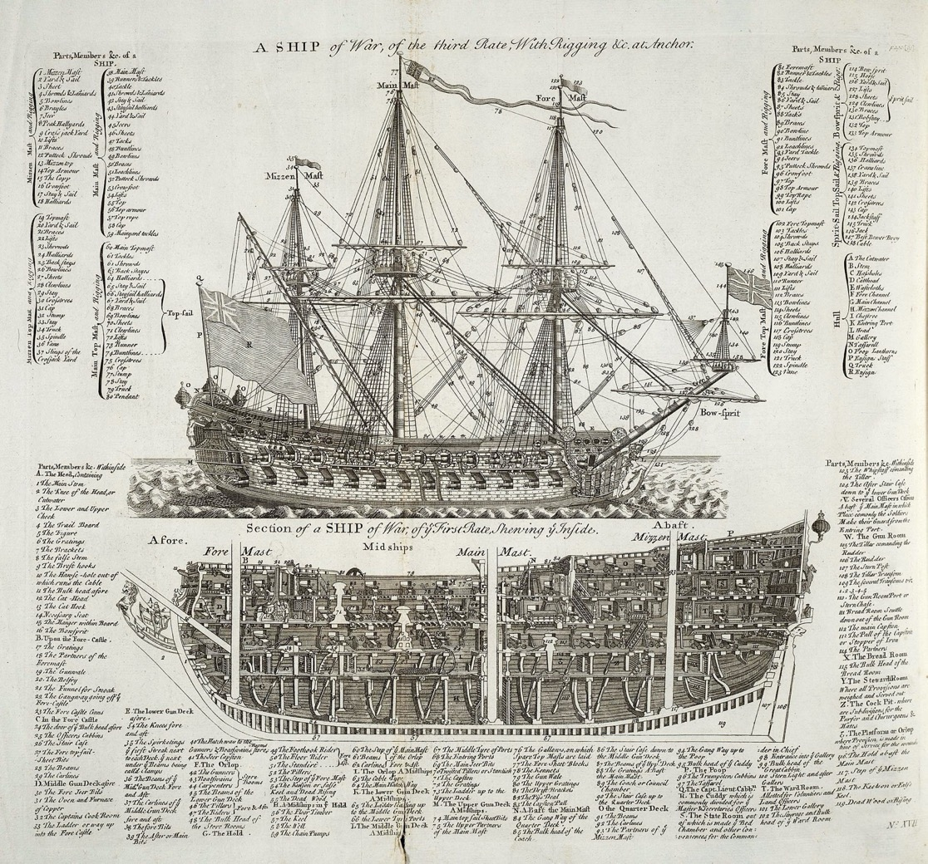
Europe
Diagram of a warship (1728) Public domain
GAHTC ©2019.
Notes:
The age of sailing, which lasted from the middle of the 16th to the middle of the 19th century, was a period in which international trade and naval warfare were dominated by sailing ships. These ships dependent extensively on wind and weather conditions as well as the seasons. Piracy was another challenge. The arrival of goods by sea could not be easily predicted; ships were without contact to land for a long time, and preparations in ports for the arrival of goods could only be made when the ships were in sight of land and cities. This period would last until industrialization in the 19th century, when steam ships appeared.
Image source:
https://commons.wikimedia.org/wiki/File:Warship_diagram_orig.jpg

Slide 5
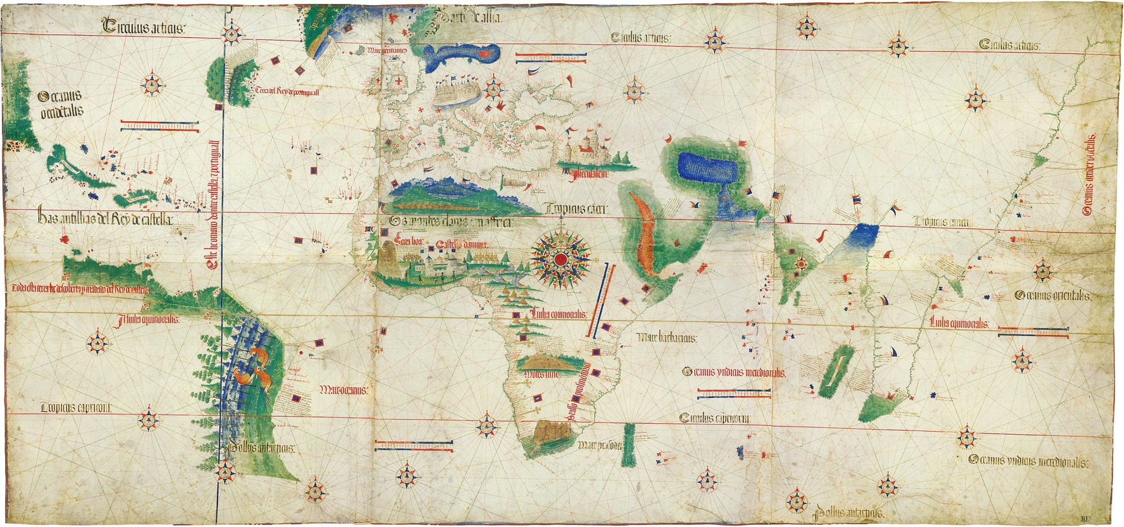
Europe
Cantino Planisphere (1502) Public domain
GAHTC ©2019.
Notes:
The Cantino Planisphere is the oldest Portuguese nautical map. It illustrates the understanding of the earth of one of the leading world powers at the beginning of the 16th century. Remarkable in this representation is the extent of only partly known coastlines and of incompletely depicted continents and thus the limits of maritime exploration. In the course of the 16th century, all these areas were to be explored by sailing ships and, to a large extent, conquered, with cultural, religious and architectural ideas from Europe being spread throughout the world.
Image source:
https://commons.wikimedia.org/wiki/File:Cantino_planisphere_(1502).jpg

Slide 6
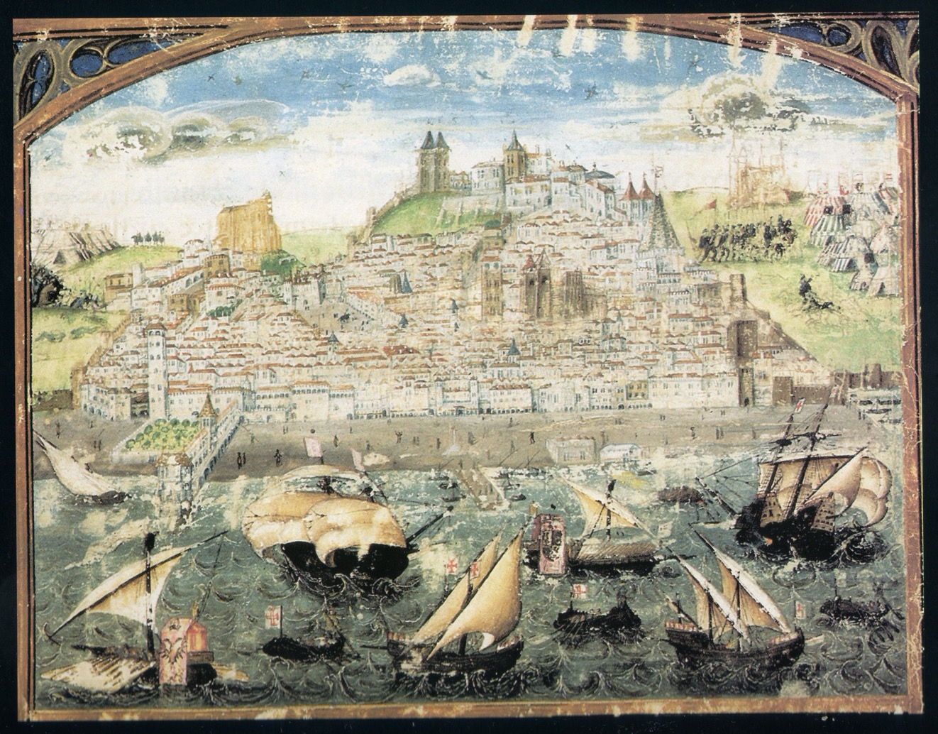
Europe
Duarte Galvão: Lisbon (ca. 1500) Public domain
GAHTC ©2019.
Notes:
Maritime power translated into urban growth, outstanding architecture and artistic representation. This is the oldest city view of Lisbon in Portugal. It was here that Christopher Columbus arrived on 4 March 1493 from his first trip to America. In the course of the 15th century, the city had developed into the most important port of the emerging maritime power, Portugal. Vasco da Gama's voyage, in which he discovered the southern sea route to India, also began and ended in Lisbon. By the middle of the 16th century, the city developed into one of the world's largest seaports as a result of the riches brought from the newly discovered areas. The gold and silver of South America and the spices of India, as well as the trade with corals and silk helped the small country to rise to a world power. The city view shows the waterfront on the river Tejo, at whose estuary the city lies. It depicts representative buildings and fortifications that speak to the power of Lisbon, capital of a maritime empire.
The building at the bottom left of the picture that reaches into the water is the Ribeira Palace, which also housed the Casa da Índia - the institution through which all the connections of the kingdom with overseas took place.
Image source:
https://en.wikipedia.org/wiki/File:Lisboa_1500-1510.jpg

Slide 7
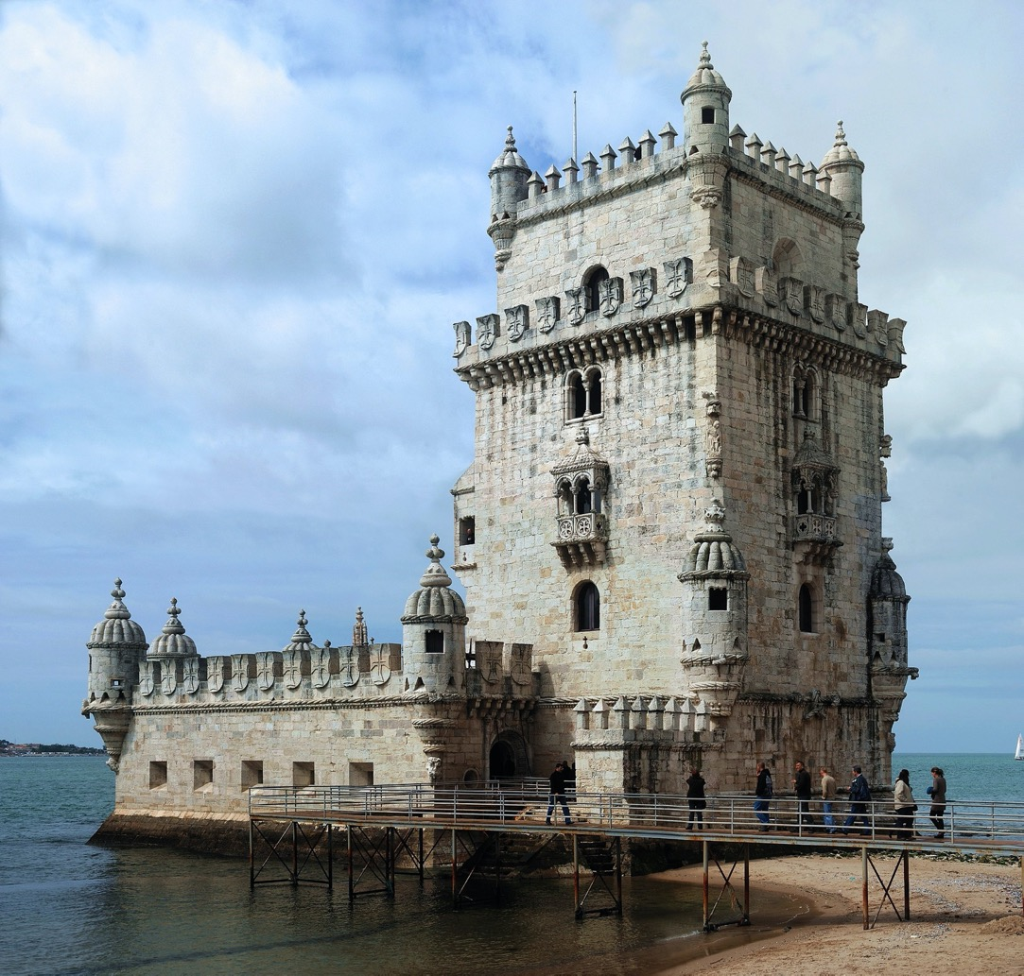
Europe
Torre de Belém (1521) CC BY-SA 3.0
GAHTC ©2019.
Notes:
The Torre de Belem is a valuable witness of Lisbon's heyday as a naval power. It was built as a weir on a rock in the estuary of the Tejo. In the past, there was a second tower on the opposite side of the river (destroyed by the earthquake of 1755) to take enemy ships into the crossfire. The tower was later used as a lighthouse and was finally restored in the 19th century. Today it is on the UNESCO World Heritage List.
Image source:
https://commons.wikimedia.org/wiki/Torre_de_Belém?uselang=de#/media/File:Torre_Belém_April_2009-4a.jpg

Slide 8
Europe
Lisbon and Sevilla (1600) Public domain
GAHTC ©2019.
Notes:
This image of 1600 shows the maritime details of Lisbon a little better. It illustrates the location with the flat banks of the river and shows some important buildings of the port. Beside the Ribeira Palace, we see warehouses, the shipyard building (Ribeira das Naus) and the administrative facilities. What is remarkable is the spatial proximity of the residence and the port, they form a unit. This symbolizes the importance of the trade relations that could only be maintained by means of the port.
On the right side you can see another port city, which at the same time became an important metropolis and is also located at a river near the estuary: the Spanish city of Sevilla.
Image source:
https://commons.wikimedia.org/wiki/File:Vier_Weltstädte_Detail.jpg

Slide 9
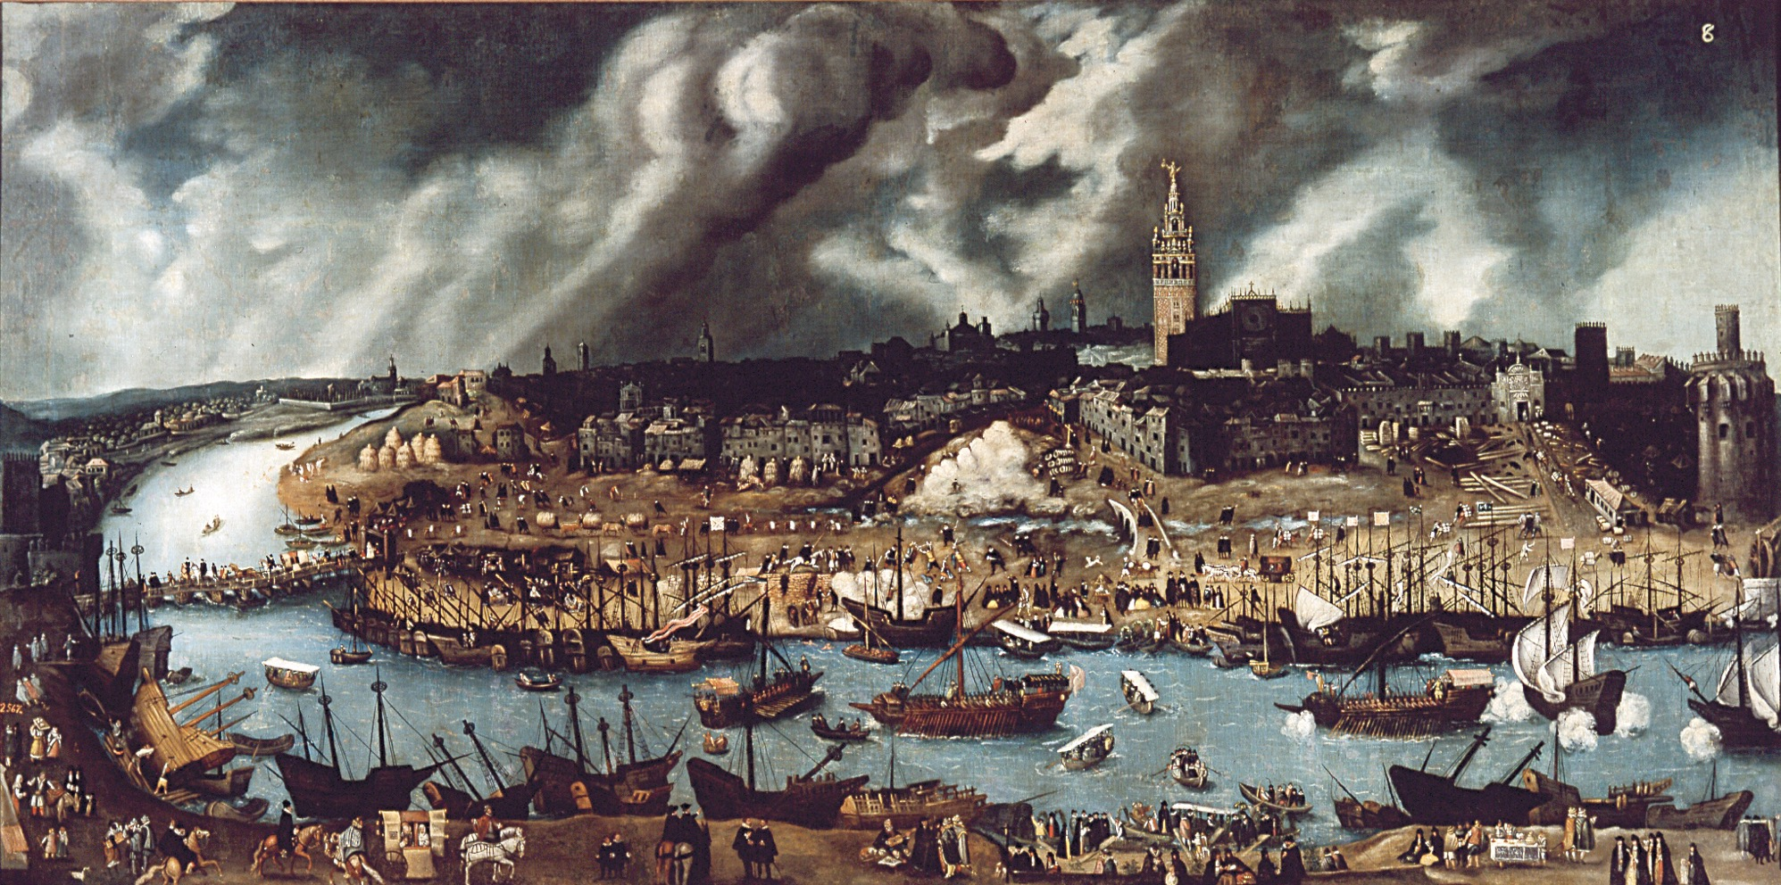
Europe
x
Alonso Sánchez Coello: Vista de Sevilla (late 16th C) Public domain
GAHTC ©2019.
Notes:
The protected inland location and the port situation with its shallow river banks are comparable to Lisbon. In addition, Seville became the most important port city of the Spanish kingdom as it received the monopoly on overseas trade. Amerigo Vespucci, the patron saint of the Americas, and Ferdinand Magellan, initiator of the first circumnavigation of the world, planned and started their voyages of discovery here.
The abundance of picture details allows a good insight into the happenings in the port. The construction of a ship, a pontoon bridge, different types of ships, trading processes and storage sites can be seen. It also becomes clear that ports at that time had relatively few specialized structures.
Image source:
https://upload.wikimedia.org/wikipedia/commons/thumb/f/f6/La_sevilla_del_sigloXVI.jpg/1600px-La_sevilla_del_sigloXVI.jpg

Slide 10
Europe
Pere Oromig: Expulsion of the Moriscos from Valencia (1616) Public domain
GAHTC ©2019.
Notes:
The painting Expulsion of the Moriscos from Valencia shows the expulsion of the descendants of Spain's Muslim population, and gives an impression of the port city of Valencia in the early 17th century, showing that port cities did not necessarily have structures that we associate with them today. Instead of harbour basins and quays, it is rather flat shores where ships can moor and where goods and people can be brought into the fortified city.
Image source:
https://commons.wikimedia.org/wiki/File:Embarco_moriscos_en_el_Grao_de_valencia.jpg

Slide 11
Europe
Plymouth (1540) Public domain
GAHTC ©2019.
Notes:
In the 17th century, several European naval powers built complex trading networks that extended across the globe. This first imperial age was made possible primarily by seafaring. Nation states, trading companies, and people from other European countries also developed ambitions to control overseas territories, expand maritime trade across the Atlantic or to find new places to live. Plymouth, situated on the south coast of England, became the starting point for numerous voyages of discovery, including (among others): In 1577 the circumnavigation of the world by Francis Drake, in 1620 the last English port which the Mayflower called at on its journey to North America. Later the voyages of James Cook and the circumnavigation of the Beagle with Charles Darwin on board started here.
Image source:
https://commons.wikimedia.org/wiki/File:Plymouth_1540.png

Slide 12
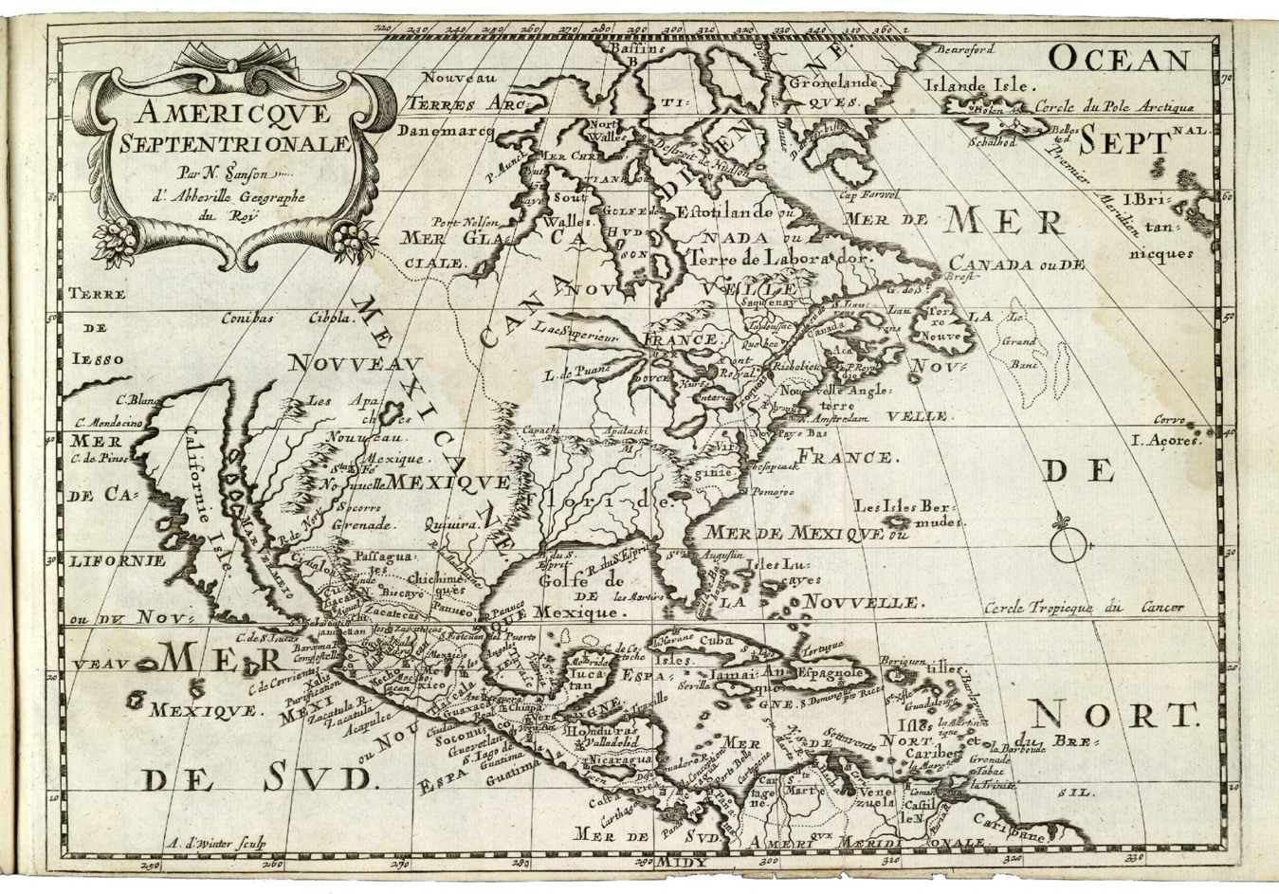
Caribbean
North America and the Caribbean (1682) Public domain
GAHTC ©2019.
Notes:
The discovery of America was followed by the rapid occupation of the land by the Spanish and Portuguese Crown. Later the Dutch, British and French followed. Cuba, which Columbus discovered on his first voyage, became an early starting point of Spanish colonization. The trip to the Americas was an opportunity for many people to escape religious persecution and to start a new life.
Image source:
https://commons.wikimedia.org/wiki/File:AMH-7919-KB_Map_of_North_America_and_the_Caribbean.jpg

Slide 13
Caribbean
City and port of Havana (1740) Public domain
GAHTC ©2019.
Notes:
Havana was founded in 1514 by the conquistador Diego Velázquez de Cuéllar on the south coast of Cuba. The city served as a hub from which the conquest of the continent to North America continued. In 1519, the city was moved to the Bay of Puerto de Carenas, due to its favourable location. It now houses the port of Havana. The city was originally a commercial port and therefore suffered from regular attacks by pirates. It was burned down in 1538 and plundered by French corsairs in 1553/1555. The city was fortified to protect people, goods and merchant ships.
Havana, like many cities in the Americas was built with a grid urban plan. The grid plan is an important export product of urban planning. Grid layouts already characterized ancient port cities. Grid planning imported from Spain also connected to layouts that the colonizers encountered in cities like Tenochtitlan (contemporary Mexico City). The grid has become the basis of many cities on the American continent.
Image source:
https://commons.wikimedia.org/wiki/File:1740_Plan_of_the_city_and_harbour_of_the_Havanna_situated_on_the_island_of_Cuba_BPL_m8628.png

Slide 14
Caribbean
Havana (17th C) Public domain
GAHTC ©2019.
Notes:
This panorama of Havana could easily be mistaken for a view of a European city. In fact, Havana was newly founded and built under the urban and architectural guidelines of the old world. Only gradually did its own formal architectural and urban characteristics develop. The city’s roots in maritime exchange with Europe, remain evident in port and city design throughout the following centuries. The chain closing of the bay is prominent on the image.
Image source:
https://de.wikipedia.org/wiki/Datei:Panorama_of_La_Habana_(Amsterdam,_17th_century).jpg

Slide 15
Caribbean
Santa Marta, city and port (1700) Public domain
GAHTC ©2019.
Notes:
Port cities were nodes of development in the Caribbean. The town of Santa Marta at the northern tip of south America (contemporary Columbia) was already founded in 1525. It was situated at a natural harbor and close to the estuary of the Manzanares river that provided access to the hinterland. The Spanish war against the native Taironas lasted nearly a century and the city was attacked several times. Today, a few of its buildings and the layout of the city remember the early days of colonialization.
Image source:
https://commons.wikimedia.org/wiki/File:Plano_del_puerto_de_Santa_Marta_situado_en_la_costa_de_Tierra_Firme_en_la_littd._N._11⁰16ʹ_y_en_la_longd._de_302⁰23ʹ_segun_el_meridiano_de_Tenerife_LOC_90682799.jpg

Slide 16
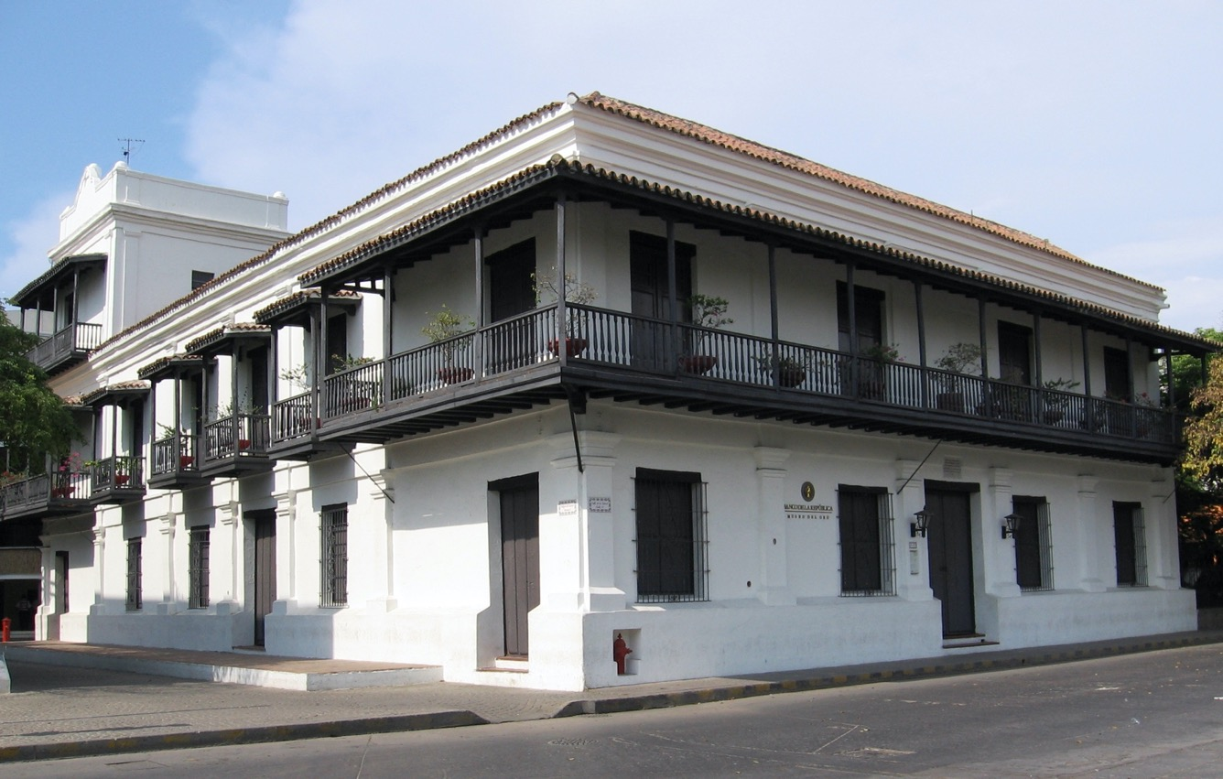
Caribbean
Casa de la Aduana (1531) CC BY-SA 3.0
GAHTC ©2019.
Notes:
Today, Colombian Santa Marta is the oldest still inhabited newly founded city on the South American continent. Some of the early colonial buildings have been preserved in it. The Casa de la Aduana shown in 1531 is considered to be one of the oldest colonial buildings in South America and its oldest customs house. It testifies to the early importance of maritime trade for the city.
Image source:
https://es.wikipedia.org/wiki/Casa_de_la_Aduana#/media/File:Casa_de_la_Aduana_(Colombia).jpg

Slide 17
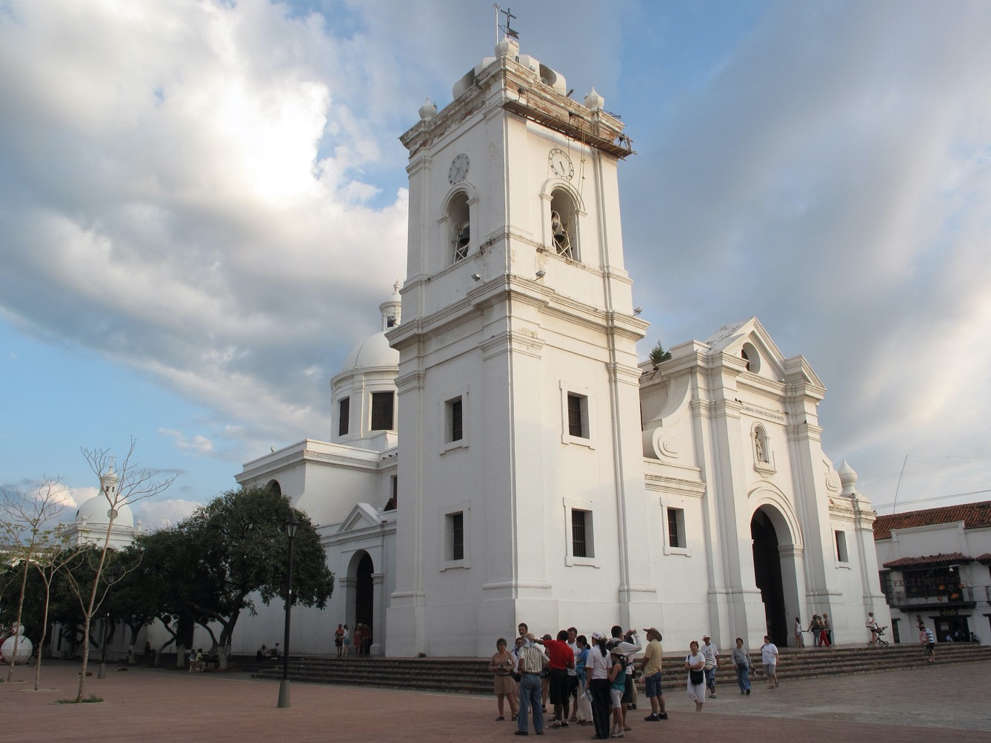
Caribbean
Cathedral of Santa Marta (2010) CC BY-SA 3.0
GAHTC ©2019.
Notes:
Santa Marta Cathedral is considered the oldest Christian church in South America. However, it has been redesigned several times. Today it appears in a Baroque 18th century robe. Churches and missions were an important element in the settlement of the American continent. The important port cities quickly received representative church buildings, which must be regarded as an essential element of colonial urban planning.
Image source:
https://commons.wikimedia.org/wiki/Category:Cathedral_of_Santa_Marta#/media/File:Catedral-santamarta.jpg

Slide 18
Caribbean
Arnoldus Montanus: Cartagena (1671) Public domain
GAHTC ©2019.
Notes:
After the occupation of the territory around Santa Marta, the government's attention focused on slave trade in Cartagena, another port city in contemporary Columbia. Santa Marta then became depopulated and decayed. Cartagena was soon heavily fortified. Even today, the fortifications still form an essential element of Cartagena's cityscape according to contemporary European standards. Here it is not so much the port facilities that tell us about a global architectural history, but rather the architectural elements of the houses and churches, the streets and squares, whose style was based on Spanish patterns.
Image source:
https://commons.wikimedia.org/wiki/File:Carthagena_Colombia_ca1600.jpg

Slide 19
Caribbean
Nuestra Señora de la Merced, Lima, Peru (19th C) Public domain
GAHTC ©2019.
Notes:
The Baroque style and in particular the special form of Churrigueresque, which predominated on the Iberian peninsula, became a style for the sacral architecture of Latin America. Typical for this style are the overloaded, small-scale decor and turned column shafts. Here you can see the facade of the Basilica and Convent of Nuestra Señora de la Merced in Lima. Like Cartagena and Santa Marta, Lima was part of the Viceroyalty of Peru, founded in 1542.
Image source:
https://commons.wikimedia.org/wiki/File:Iglesia-la-merced-lima-peru.jpg

Slide 20
Caribbean
San Juan de Puerto Rico (1770) Public domain
GAHTC ©2019.
Notes:
Another important urban planning element is the Plaza de Armas, which developed from the Spanish Plaza Mayor. The Plaza des Armas is the central square of a city, where the town hall, the arsenal of weapons and the main church are located. It also served as a place for appeals and military gatherings. In many Latin American cities, the Plaza des Armas still plays a central role today, it is representatively decorated and often very lively. On the map of San Juan, the Plaza des Armas (A) is clearly visible. It is lined by the cathedral (B), the seat of government (K) and the monastery (Q). The mooring quay is located in the protected bay (E).
Image source:
https://commons.wikimedia.org/wiki/File:Plano_de_la_ciudad_de_S._Juan_de_Puerto_Rico._LOC_2004631685.jpg

Slide 21
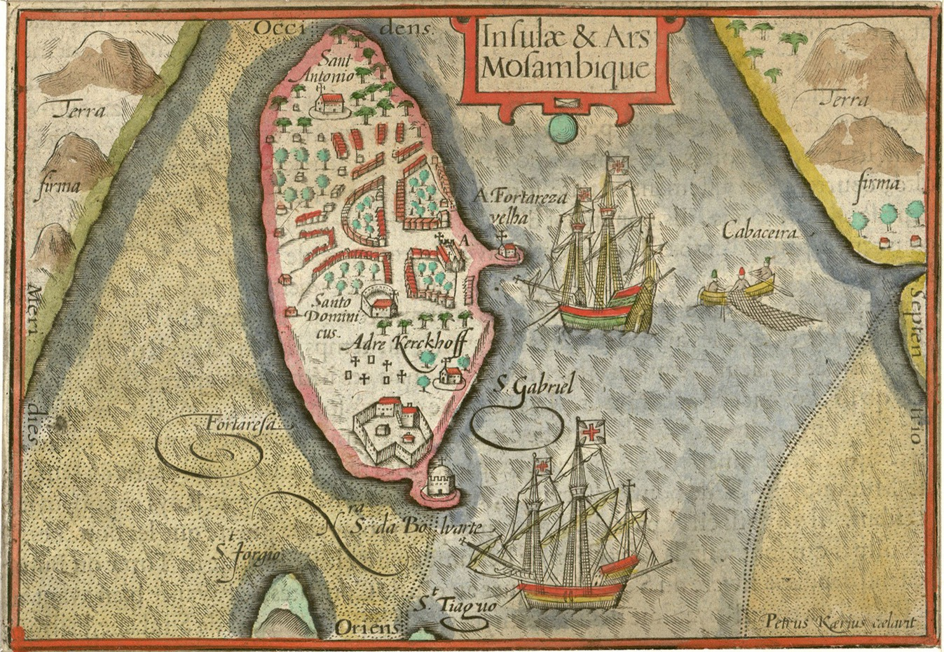
Caribbean
Pieter van den Keere: Island and fortress of Mozambique (1598) Public domain
GAHTC ©2019.
Notes:
In the Treaty of Tordesillas in 1494 the world was divided into a Spanish and a Portuguese half. This was done to avoid a confrontation between the world powers. Spain therefore had all the territories west of the length of 46° 37′ West, Portugal the territories east of it. Other great naval powers such as England and France did not recognise the treaty. The Treaty is the reason that Portuguese colonies were also located in Africa and India. This also includes the Island of Mozambique. In 1507 the Portuguese established a port and a naval base there.
Image source:
https://en.wikipedia.org/wiki/File:1598_Mosambique_Kaerius.jpg

Slide 22
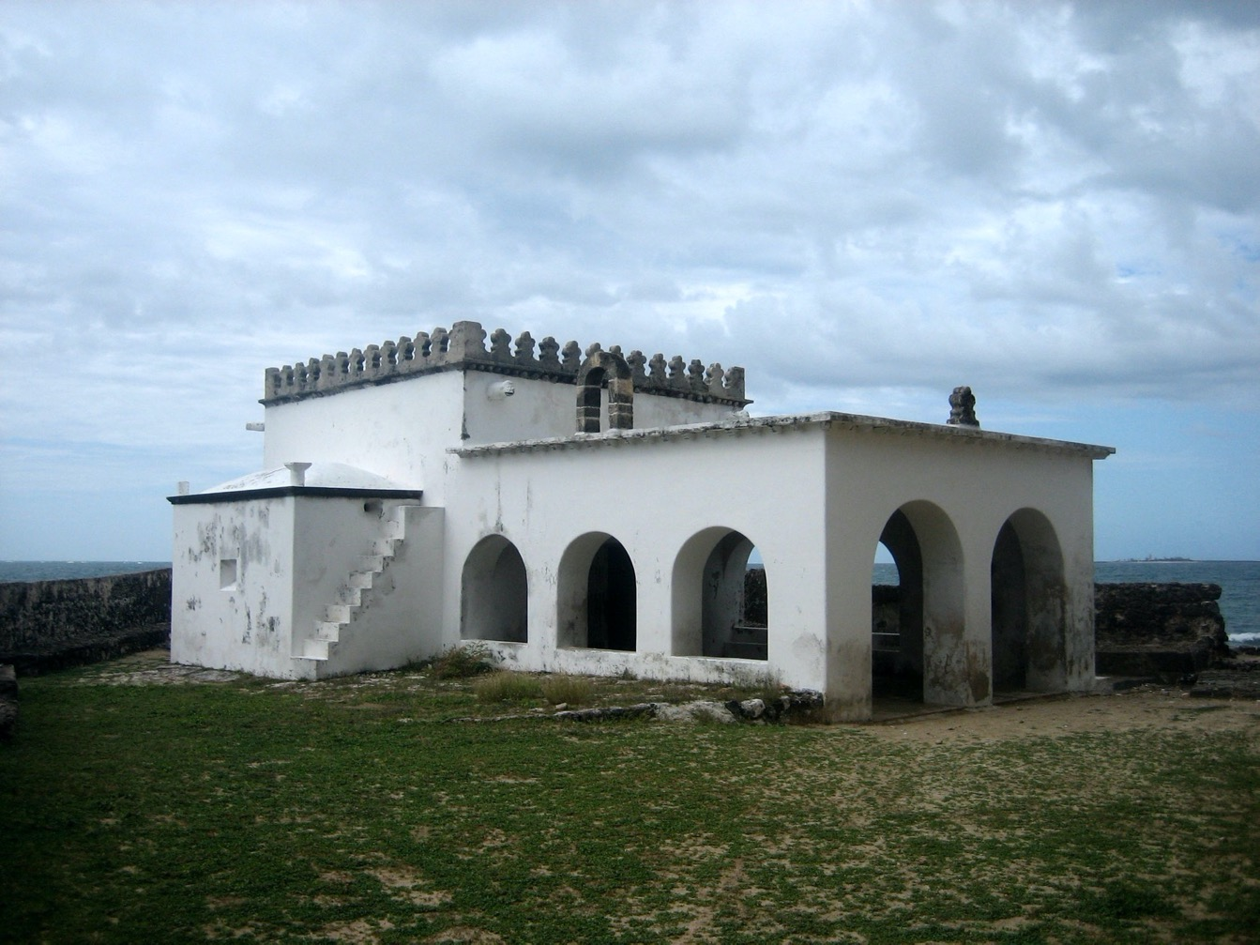
Caribbean
Nossa Senhora do Baluarte chapel (1522) CC BY 2.0
GAHTC ©2019.
Notes:
Built in 1522, the Capela de Nossa Senhora do Baluarte is considered the oldest colonial building on the coast of the Indian Ocean and the oldest European building in the southern hemisphere. It is a Roman Catholic chapel in the far north of the Island of Mozambique. The chapel is a rare example of the Manueline style, which we have already encountered in the Torre de Belem in Lisbon. This style, a transition between late Gothic and Renaissance, is the earliest Portuguese colonial style. In a few examples it can be found in the vast areas of the Portuguese colonial empire.
Image source:
https://commons.wikimedia.org/wiki/File:Nossa_Senhora_do_Baluarte.jpg

Slide 23
Caribbean
Fortress of Mozambique (1655) Public domain
GAHTC ©2019.
Notes:
The island of Mozambique had strategic importance as the navigational benchmark of the shipping route that connected Lisbon with Goa and became one of the meeting points of the boats that spread during the voyage. In 1558-1620 the São Sebastião fortress was built - entirely of stones that formed the ballast of the ships. This fortress was very important because it became the centre of the exchange of goods.
Forts were an important part of the colonial expansion and the newly founded or conquered port cities. They served as protection against attacks from land and sea. Finally, they are also a symbol of the violence that accompanied the colonial conquest: countless buildings and places were irretrievably destroyed in order to assert European ideals.
Image source:
https://upload.wikimedia.org/wikipedia/commons/f/f7/Planta_da_fortaleza_da_ilha_de_Moçambique%2C_Leonardo_de_Ferrari%2C_1655.jpg?uselang=de

Slide 24
Caribbean
St. Angelo Fort , Kannur, India (1795) Public domain
GAHTC ©2019.
Notes:
The St. Angelo Fort in Kannur, which is still preserved today, is also such a symbol. It was built in 1505 by the first Portuguese viceroy of India. The Dutch conquered the fort from the Portuguese in 1663. They modernized it and built the bastions Hollandia, Zeelandia and Frieslandia, which are the main features of today's structure. This is a great example of competition and warfare among the various shipping empires.
Image source:
https://en.wikipedia.org/wiki/St._Angelo_Fort#/media/File:Cannonore_fort_%26_Bay%27;_a_watercolor_by_John_Johnston,_c.1795-1801.jpg

Slide 25
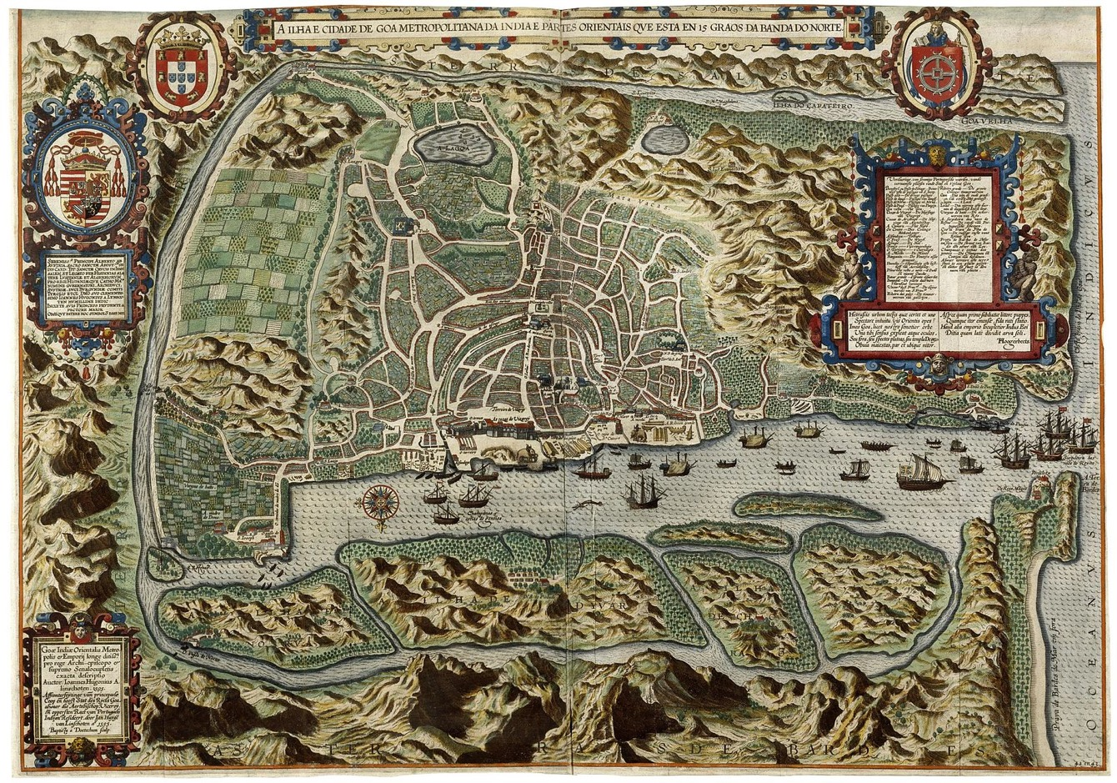
Caribbean
Jan Huyghen van Linschoten: City of Goa (1596) Public domain
GAHTC ©2019.
Notes:
Better known are the buildings in the city of Velha Goa, founded in the 15th century as a port on the banks of the river Mandovi. Conquered by the Portugese, it became the capital of Portuguese India since 1510, and symbolizes a vivid testimony to the spread of European architectural traditions. Around 1550 Velha Goa was the centre of Christianisation in the East, which can still be seen today in the numerous sacred buildings. The Dutch Oostindische Compagnie (VOC) tried to create a similar important centre for trade and culture by founding Batavia on Java. From 1636 Goa was besieged by VOC ships for eight years, so that the Portuguese repatriation fleet could no longer sail. The siege was the beginning of the decline of the city, which was sealed by a severe malaria and cholera epidemic.
Image source:
https://en.wikipedia.org/wiki/File:AMH-6577-KB_Bird%27s_eye_view_of_the_city_of_Goa.jpg

Slide 26
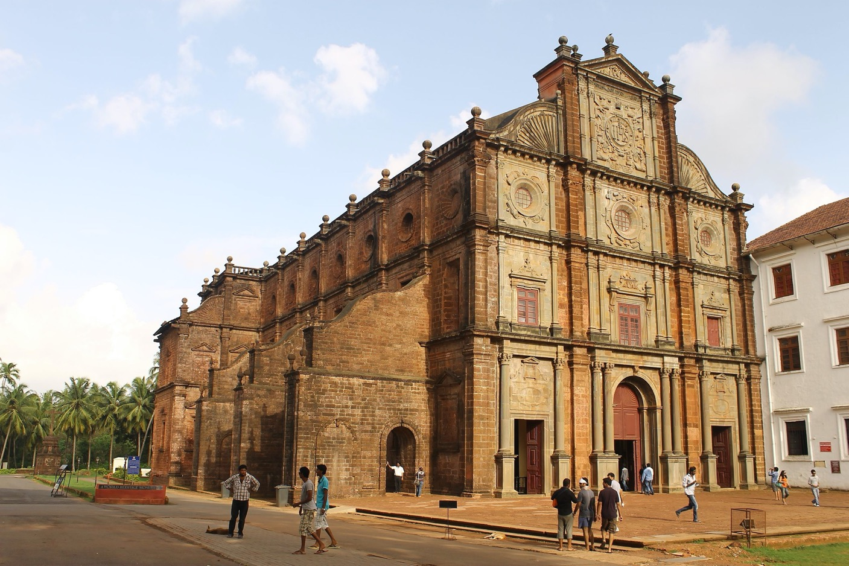
Caribbean
Basilica of Bom Jesus, Goa, India (1605) CC BY-SA 3.0
GAHTC ©2019.
Notes:
The Basilica of Bom Jesus is one of the best examples of European architecture in Goa. It was built between 1594 and 1605. The structure of the building follows a mannerist style with rich ornaments. The design also inspired the famous church of São Paulo de Macau, which today lies in ruins.
Image source:
https://commons.wikimedia.org/wiki/File:Church_of_St._Francis_Xavier,_old_goa.JPG?uselang=de

Slide 27
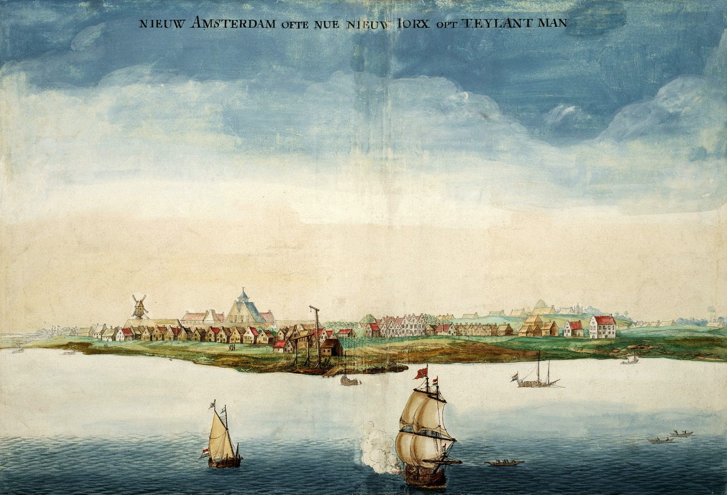
North America
Johannes Vingboons: New Amsterdam (1664) Public domain
GAHTC ©2019.
Notes:
The Spanish colonial territories mainly extended to the Caribbean and the western part of South America. The Portuguese empire comprised the eastern territories of South America as well as the southern coasts of Africa and India. Meanwhile large parts of North America were occupied by the British, the French and the Dutch. This influence can still be seen today in the architecture.
A well known port city with Dutch origins was New Amsterdam, now New York. Situated at the southern tip of Manhattan, it became the administrative center of New Netherlands. On this contemporary representation the settlement looks like a Dutch city. Gabled houses, a windmill and a double gabled house characterise the coastal settlement, which is laid out in almost treeless meadows.
Image source:
https://upload.wikimedia.org/wikipedia/commons/thumb/e/e2/GezichtOpNieuwAmsterdam.jpg/1920px-GezichtOpNieuwAmsterdam.jpg

Slide 28
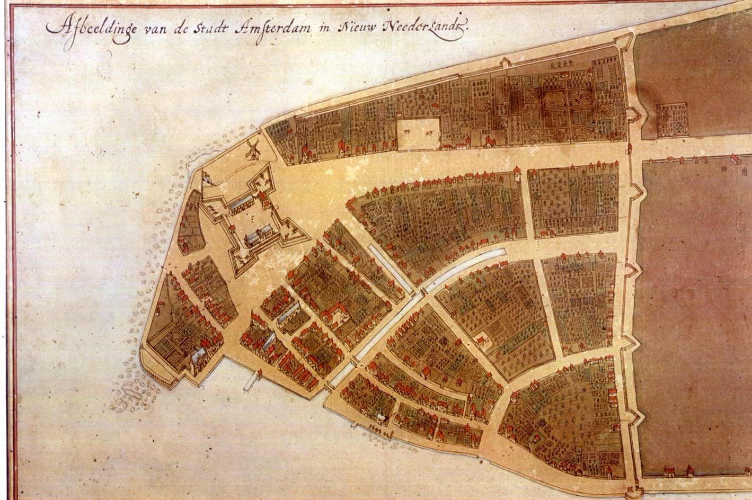
North America
Jacques Cortelyou: New Amsterdam (1660) Public domain
GAHTC ©2019.
Notes:
In the case of New Netherlands, not only urban planning and architectural elements (canals, blocks with edge buildings, interior gardens, windmills) were imported, but also the art of cartography. At that time, the Dutch were the leading cartographers and they documented the development of the city in minute detail. You can see Broadway, the northern wall is todays Wall Street. The canal from the port was filled in 1676 and became Broad Street.
Image source:
https://upload.wikimedia.org/wikipedia/commons/thumb/e/e2/GezichtOpNieuwAmsterdam.jpg/1920px-GezichtOpNieuwAmsterdam.jpg

Slide 29
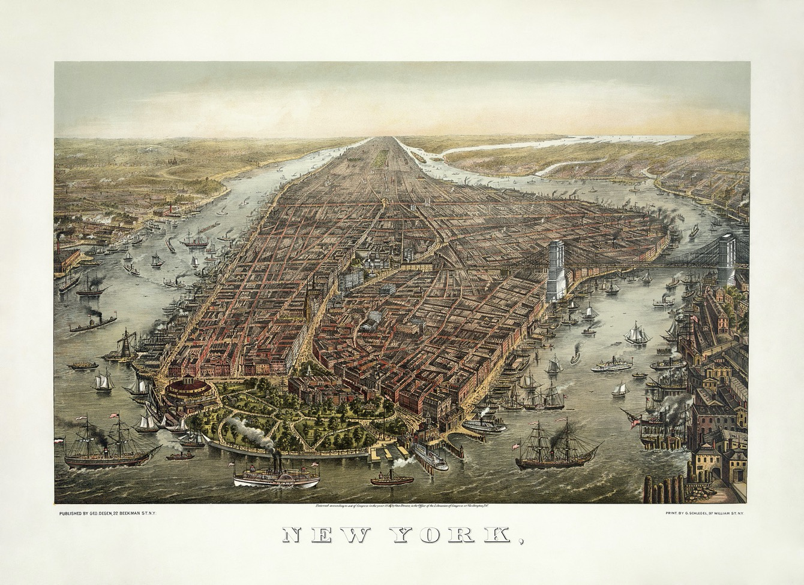
North America
George Schlegel and Adam Cuerden: Manhattan (1873) Public domain
GAHTC ©2019.
Notes:
Two centuries later, the city had undergone a major transformation and was on its way to becoming the most important trading metropolis in the world. New York was the most important American port of call for European migrants, who have shaped the city in many different ways. Manhattan's appearance today is mainly influenced by the Commissioners' Plan of 1811, a rigid grid plan that divides Manhattan’s surface into uniform rectangles.
The small settlement at the southern tip of the island soon spread northwards. In order to support an orderly development, this proposal of the state government was accepted and radically implemented. In the 19th century grid plans for cities like New York allowed for the purchase of land based on maps and in far away places. Buyers could be assured that the lots were of similar value. Only the Central Park was added later, read the need for a park was recognized. Almost all the streets of the grid lead to the port - the city is practically surrounded by quays and jetties. But we will return to New York later.
Image source:
https://upload.wikimedia.org/wikipedia/commons/thumb/4/49/George_Schlegel_-_George_Degen_-_New_York_1873.jpg/1920px-George_Schlegel_-_George_Degen_-_New_York_1873.jpg

Slide 30
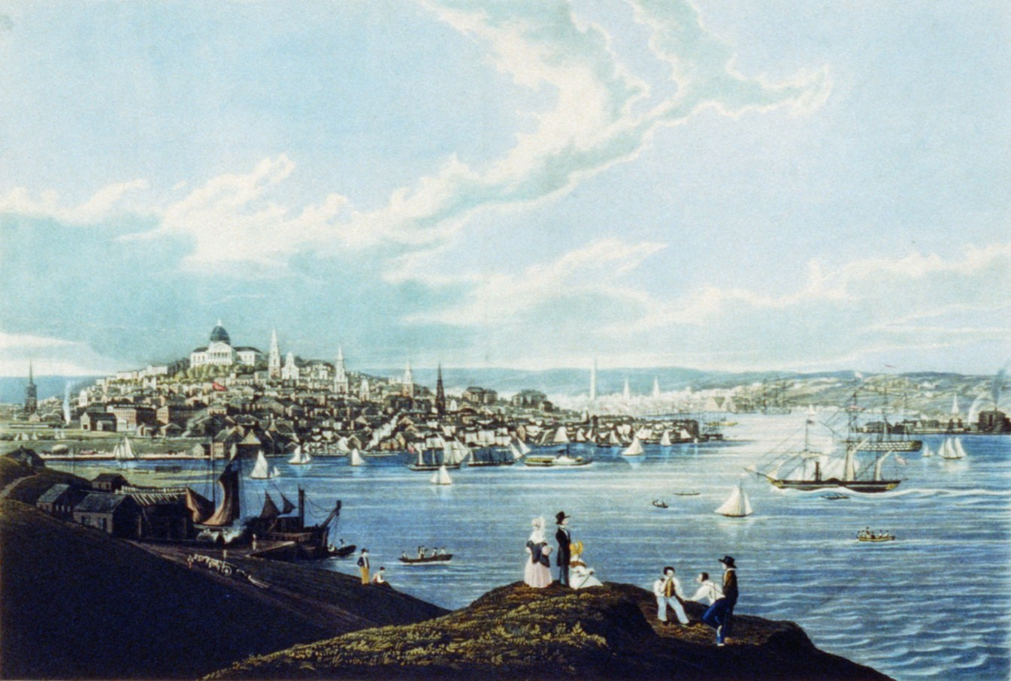
North America
Robert Havell: Boston View (1841) Public domain
GAHTC ©2019.
Notes:
Boston, the largest city in New England, became one of the richest trading ports in the world after the American Revolution (1765-1783). It mainly handled fish, rum, salt and tobacco. Between 1630 and 1890, the city area tripled, mainly due to land reclamation, a key planning feature of many port cities. Land reclamation is a particularity of many port cities that have the unique opportunity of expanding their territory into the sea. Boston had the advantage of being able to expand into the shallow waters of the Charles River and Massachusetts Bay. As a result, Boston's coastline has changed dramatically. The large number of quays and jetties that characterize the cityscape, however, were also present earlier.
Image source:
https://upload.wikimedia.org/wikipedia/commons/2/22/Boston-view-1841-Havell.jpeg

Slide 31
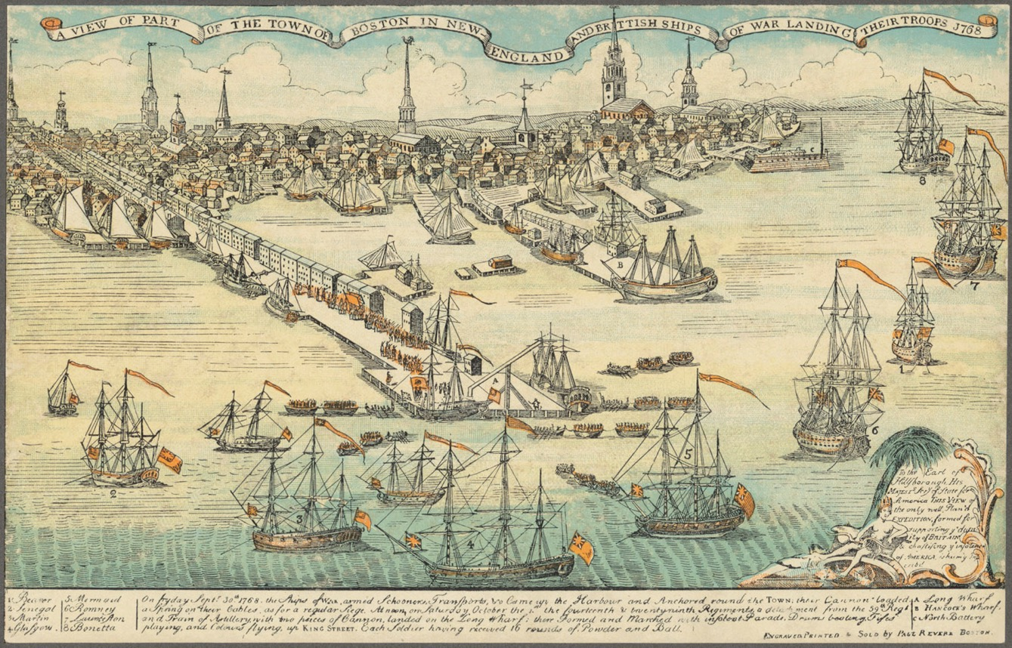
North America
Boston (1768) Public domain
GAHTC ©2019.
Notes:
The Long Wharf, which still exists today, dates back to the early 18th century. Previously, it was 800 metres long. As an extension of State Street, Long Wharf was directly connected to the city and shopping centre of Boston. It offered berths for 50 ships, making it the largest of the city's 80 wharves. Warehouses and trading houses were arranged on the wharf in such a way that a north-south passage passed between them. To ensure a uniform appearance, buildings should not exceed a certain height. Long Wharf was Boston's centre for maritime trade, which included both coastal and international trade. It has been continuously developed to meet the current requirements of Boston's maritime trade.
Image source:
https://commons.wikimedia.org/wiki/File:Boston_1768.jpg

Slide 32
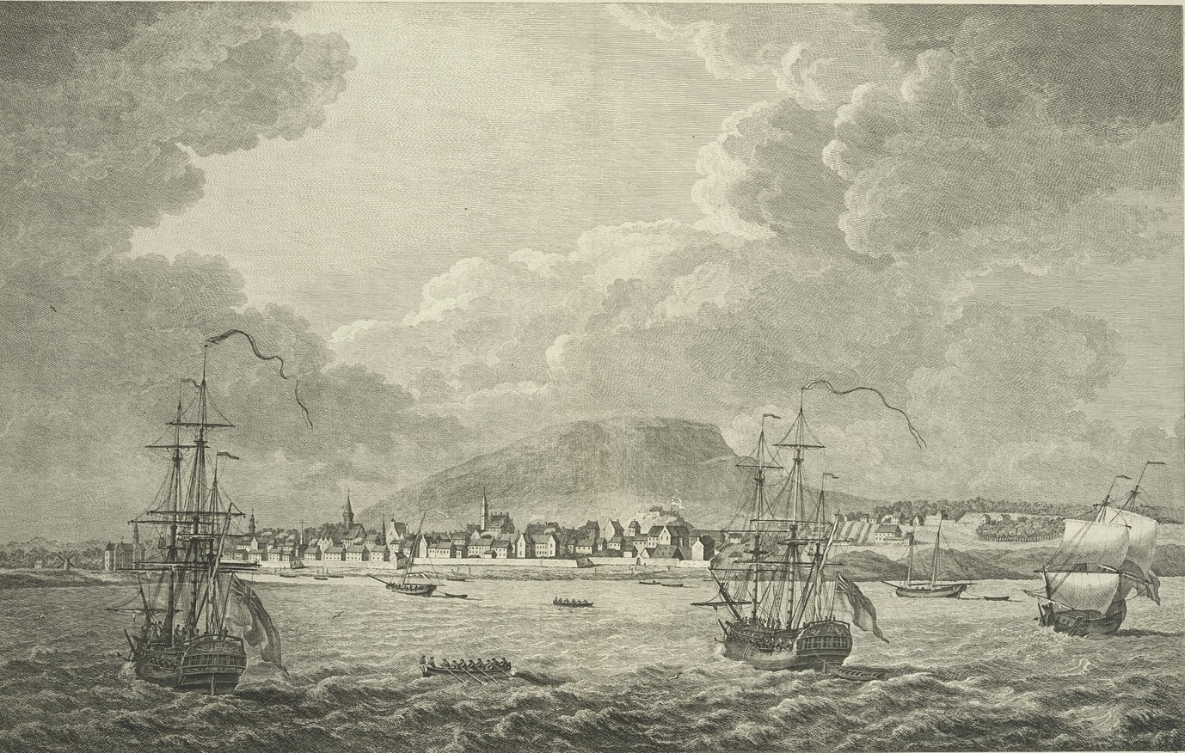
North America
Pierre Charles Canot: An east view of Montreal in Canada (1762) Public domain
GAHTC ©2019.
Notes:
Montreal in Canada is a good example of a seaport that is not located on the coast. The city is located at the crossroads of several trade routes and an important waterway. Originally, the port consisted of simple moorings for canoes, flat boats and barges. In contrast to the English settlers who came to stay, many of the French came to Northern America to gain access to goods that they could take back home. In 1809, steamships were first operated to and from Montreal. From 1830, the first permanent wharves and piers were built. The main reason for its importance is its location on the St. Lawrence River, one of the largest rivers in North America. On it can move far inland and have been faster to reach the Midwest region.
Image source:
https://upload.wikimedia.org/wikipedia/commons/thumb/5/51/An_east_view_of_Montreal%2C_in_Canada_%3D_Vue_orientale_de_Montréal%2C_en_Canada_%28NYPL_Hades-118226-53931%29-no_text.jpg/1920px-An_east_view_of_Montreal%2C_in_Canada_%3D_Vue_orientale_de_Montréal%2C_en_Canada_%28NYPL_Hades-118226-53931%29-no_text.jpg

Slide 33
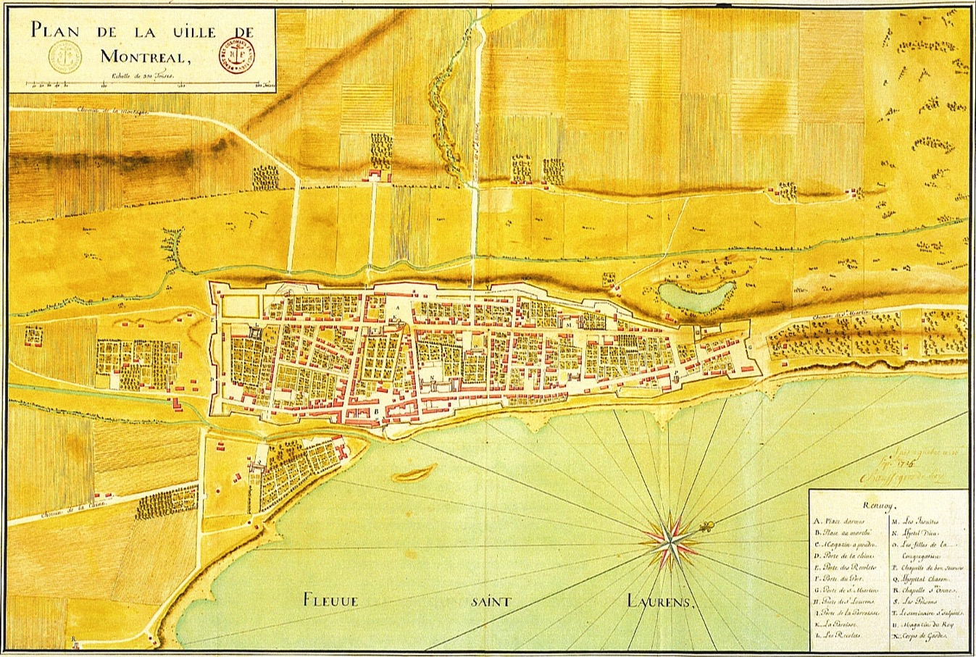
North America
Gaspard-Joseph Chaussegros de Léry: Montreal (1725) Public domain
GAHTC ©2019.
Notes:
The Old Port stretched over a length of two kilometers along the banks of the St. Lawrence River and bordered today's Montreal Old Town. Its remnants are still visible today. The port included piers connected by a promenade along the riverbank. It was located at the place where in 1611, Samuel de Champlain set up a temporary fur trading post. There, French colonists later founded the Fort Ville-Marie, which subsequently developed into the city of Montreal. For the growth of the city, the ice-free port was of decisive importance during the next three centuries. It can be seen how the early city developed along the riverbank, given the importance of the access to the water.
Image source:
https://commons.wikimedia.org/wiki/File:Montreal_1725.jpg

Slide 34
North America
John Lowell Gardner: Port od Salem (~1770) Public domain
GAHTC ©2019.
Notes:
The representation of the Port of Salem (Massachusetts) illustrates the diverse infrastructure that ports had in past centuries. In addition to large storage and shipyard buildings used for the mass production of sailing ships, work is also being carried out on unpaved shores. The improvised bridge and activity during the repair and loading of the ship in the foreground illustrate maritime practices.
Image source:
https://commons.wikimedia.org/wiki/File:Salem_shipping_colonial_color.jpg

Slide 35
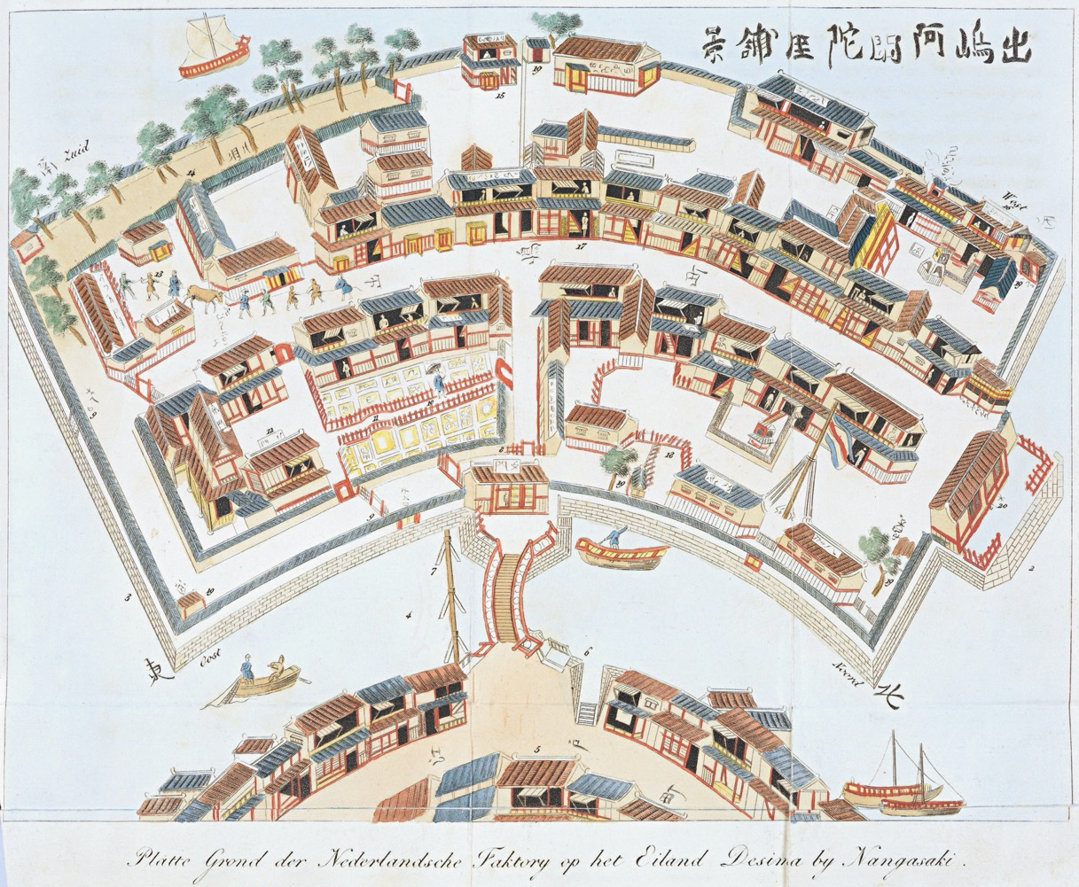
Asia
Isaac Titsingh: Map of Dejima (1824) Public domain
GAHTC ©2019.
Notes:
Trading networks also extended eastwards. Dejima in Japan is a very special form of a port city. Actually it is an artificial island in the Bay of Nagasaki. It was built around 1635 to accommodate the scattered Iberian merchants who had been in contact with Japan since 1543, and the Dutch who had travelled to Japan since 1600. The Japanese disliked the missionary activity of the Catholic traders, whereupon from 1639 only the Dutch who were exclusively interested in trade were allowed to travel to Japan (this situation existed until 1854). But the Dutch merchants were only allowed to stay on the island of Dejima. Japanese were also forbidden to enter Dejima, with the exception of interpreters, cooks, carpenters, employees and "Women of Pleasure". Dejima is a unique example of the unique combination of exchange and seclusion.
Image source:
https://upload.wikimedia.org/wikipedia/commons/5/50/Plattegrond_van_Deshima.jpg

Slide 36
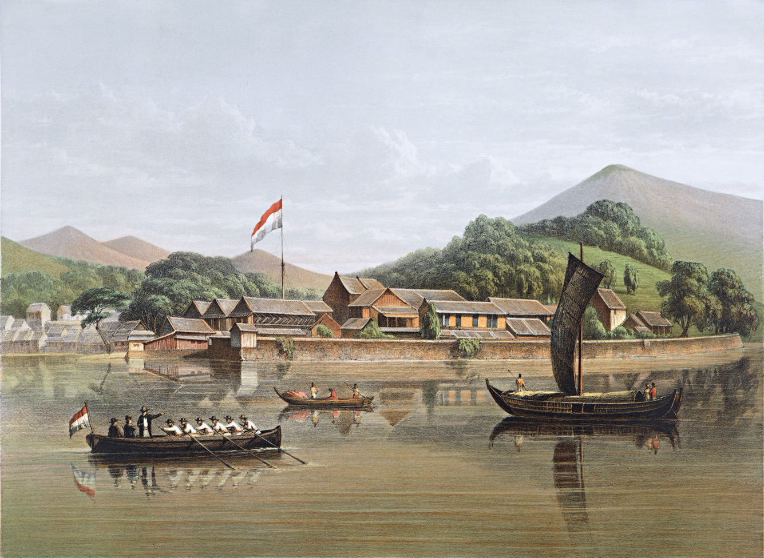
Asia
Carl Wilhelm Mieling and Johan Maurits van Lijnden: Dejima (19th C) Public domain
GAHTC ©2019.
Notes:
Contemporary illustrations show the Japanese character of the Dejima development. Despite strictly regulated access, the Dutch brought many products and information to and from Japan via Dejima. Ports for Chinese and Russian traders were located nearby creating another line of cross-cultural exchange between Japan and its Asian neighbors that is still under researched. The great interest in Western culture only began in Japan after the opening in the middle of the 19th century. Today, the restored Dejima in contemporary Nagasaki can only partly be recognized as an island due to the land reclamation that took place around it.
Dejima is perhaps the most striking example of the global exchange of ideas along shipping routes.
Image source:
https://upload.wikimedia.org/wikipedia/commons/thumb/1/1e/Desima_by_CW_Mieling.jpg/1600px-Desima_by_CW_Mieling.jpg

Slide 37
Literature
Basil W Bathe, Jean Merrien, and Joseph Jobé.
The Great Age of Sail.
Cambridge: Stephens, 1977.
US National Park Service.
Salem: Maritime Salem in the Age of Sail.
Washington, D.C: U.S. Department of the Interior, 1987.
Peter Stone and Nick Buxey.
The History of the Port of London: A Vast Emporium of All Nations.
Barnsley, South Yorkshire : Pen & Sword History, 2017.
Franklin W. Knight, Peggy K. Liss.
Atlantic Port Cities: Economy, Culture, and Society in the Atlantic World, 1650-1850.
Univ. of Tennessee Press, 1991.
Michael Naylor Pearson.
Port Cities and Intruders: The Swahili Coast, India, and Portugal in the Early Modern Era.
Johns Hopkins University Press, 1998.
GAHTC ©2019.
Notes:
Thanks for listening. Here are a few relevant references.

