Slide 1
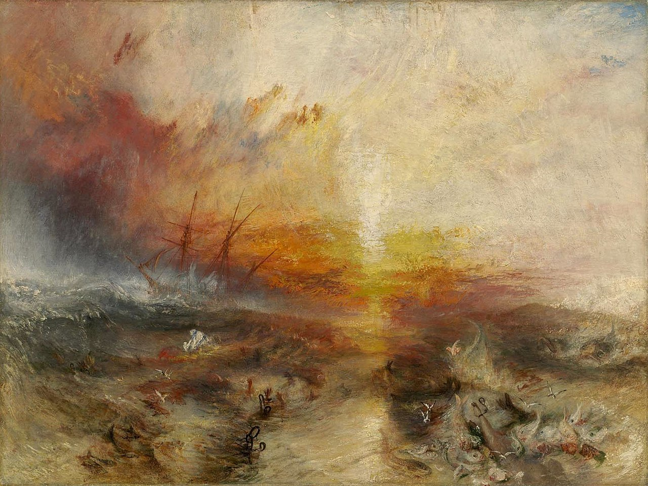
Port Cities
Between Global Networks
and Local Transformations
Carola Hein, Tino Mager
Lecture 6: Colonial and Slave ports
GAHTC ©2021
Notes:
Welcome to Lecture 6 of Port Cities between global networks and local transformations. My name is Carola Hein and I would like to lead you through this exploration of colonial and slave ports
Image:
JMW Turner: Slavers Throwing overboard the Dead and Dying – Typhon coming on (1840) Public Domain
Image source:
https://en.wikipedia.org/wiki/The_Slave_Ship#/media/File:Slave-ship.jpg

Slide 2
Port Cities
Between Global Networks
and Local Transformations
Carola Hein, Tino Mager
Lecture 6: Colonial and Slave ports
GAHTC ©2019
Notes:
Lecture Abstract:
Many port cities grew with the global slave trade, a multi-continental system of commerce and exploitation. European traders captured people in Africa, enslaved them and shipped them to American ports for sale. The slave trade is the largest involuntary migration movement of all time and has left its mark to this day. This dark chapter of the port cities’ history has left few material traces, they have to be searched very carefully.
Image:
JMW Turner: Slavers Throwing overboard the Dead and Dying – Typhon coming on (1840) Public Domain
Image source:
https://en.wikipedia.org/wiki/The_Slave_Ship#/media/File:Slave-ship.jpg

Slide 3
Port Cities
Between Global Networks
and Local Transformations
Carola Hein, Tino Mager
Lecture 6: Colonial and Slave ports
Part One: Europe
Part Two: Africa
Part Three: America
GAHTC ©2019.
Notes:
This lecture explores port city architecture and urbanism in the slave trade triangle between Europe, Africa and the Americas.

Slide 4
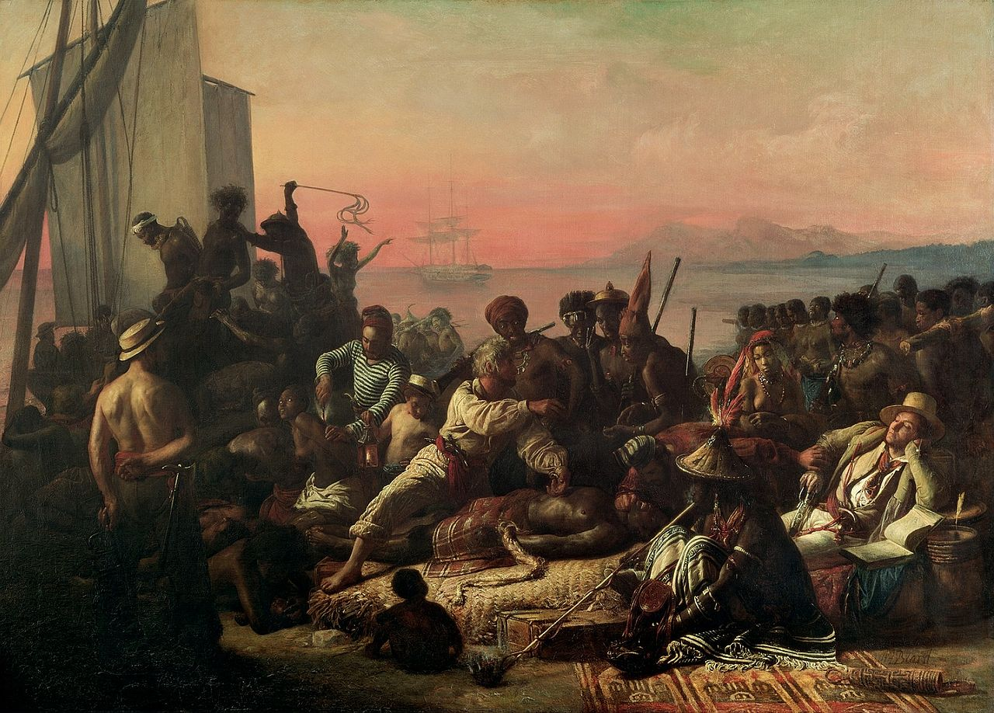
Slave Trade
"The Slave Trade" by Auguste François Biard (1840) Public Domain
GAHTC ©2019.
Notes:
The slave trade period is one of the dark sides of the history of port cities. Biard's large-format painting shows the inhumanity of the colonial rulers who treated Africans like goods. People are delivered, examined, branded, beaten and transported. Statistics are kept indifferently and economic advantages are considered. Biard made this painting towards the end of the slave era, when reformers successfully fought for the abolition of slavery.
Image source:
https://en.wikipedia.org/wiki/Atlantic_slave_trade#/media/File:The_Slave_Trade_by_Auguste_Francois_Biard.jpg

Slide 5
Slave Trade
Triangular trade (2011) CC BY-SA 3.0
GAHTC ©2019.
Notes:
Maritime trade works best when ships are constantly filled. Triangular trade refers to the exchange of "goods" between Europe, the New World and Africa. Rum, textiles and manufactured goods were brought from Europe to Africa, where they were exchanged for slaves who were captured from their homes. The slaves were shipped to the colonies of the New World to serve as unpaid labour. From the colonies, raw materials such as sugar, tobacco and cotton were brought to Europe for further processing.
Image source:
https://commons.wikimedia.org/wiki/File:Triangular_trade.svg

Slide 6
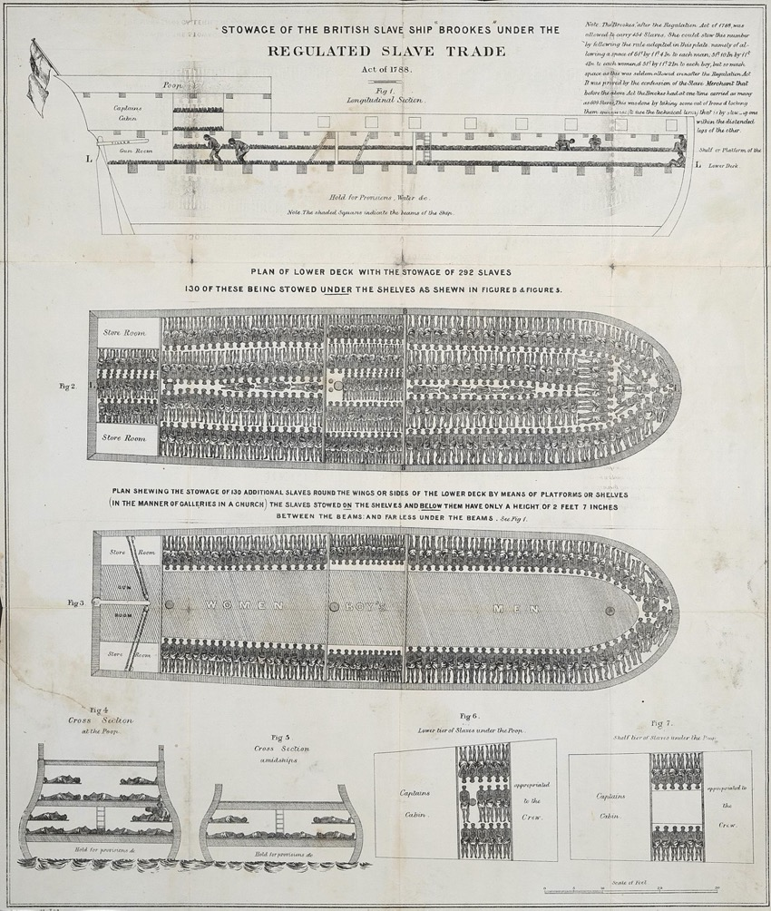
Slave Trade
African slaves on a British ship (1788) Public Domain
GAHTC ©2019.
Notes:
Ships were filled to the brim with whatever good they carried: including people. Slave ships transported men, women and children in inhumane conditions and many people died during the voyage.
The 1688 Germantown Quaker Petition Against Slavery was the first written protest against the inhumane slave trade. These early activists experienced a strong resistance from the slave traders. Their opposition was slow to reach public awareness.
In 1788, the Society for Effecting the Abolition of the Slave Trade published an engraving of the Brooks, a British slave ship that illustrates the harsh conditions of slave transport across the Atlantic. Even though the illustration is not correct – and so many details are missing - it still had a great impact and became an icon of the cruelty of the slave trade.
Image source: https://en.wikipedia.org/wiki/Triangular_trade#/media/File:Slaveshipposter.jpg

Slide 7
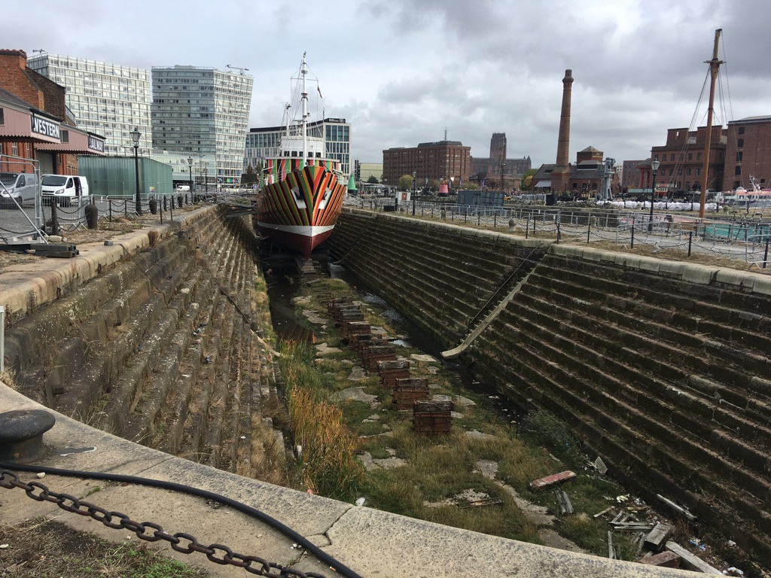
Europe
Liverpool dry docks (2018) Tino Mager
GAHTC ©2019.
Notes:
From 1740 on merchants from Liverpool dominated the slave trade until the end. In the approximately 5000 crossings organized from Liverpool in the 18th century, one and a half million slaves were shipped from Africa to the Americas.
The dry docks where slave ships were built and maintained date from 1756 to 1769.
Image source:
Tino Mager

Slide 8
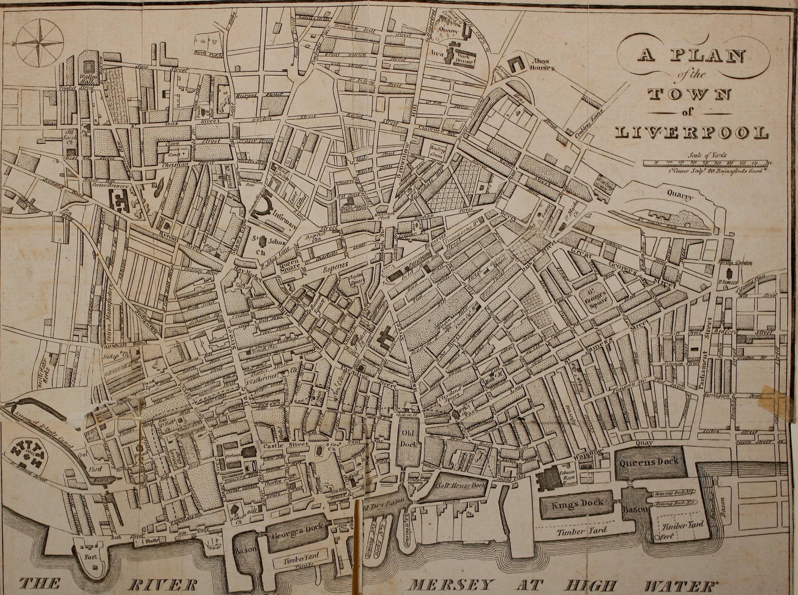
Europe
Map of Liverpool, UK (1808) Public domain
GAHTC ©2019.
Notes:
At the beginning of the 18th century the first gated docks were built in Liverpool. Gates were used to separate the docks from the river so that the ships remained at the same height during low tide, which made loading and unloading much easier. The gates can be seen in the picture below. Liverpool became rich as a result of the slave trade. It is not so much a special infrastructure in the port that today points to its use as a slavery port, but rather the representative buildings in the city. When the movement to abolish the slave trade began in Britain in 1787, the slave market in Liverpool was considered the largest in the world. Approximately 40 per cent of world trade at that time was handled through the port of Liverpool. Even after the abolition of the slave trade, the old trade routes built via the slave trade continued to play a role and contributed to the economic prosperity of the city. About one in four Europeans who set sail for the New World took an emigrant ship leaving from Liverpool - a total of nine million people. The story of how the transport of people—first slaves and later migrants—enriched port cities and needs to be examined more carefully.
Image source:
https://commons.wikimedia.org/wiki/File:The_picture_of_Liverpool;_(1808)_(14758854446).jpg

Slide 9
Europe
Albert Dock Liverpool, UK (2008) Public domain
GAHTC ©2019.
Notes:
Liverpool's history is told at the International Slavery Museum, which is part of the Merseyside Maritime Museum. Housed in the Royal Albert Dock, the historic site provides an overview of the dimensions of the slave trade arranged and conducted from Liverpool. The exhibits illustrate the global network of the slave trade and international participation in oppression and exploitation.
Image source:
https://commons.wikimedia.org/wiki/File:Albert_Dock_Liverpool_7.jpg

Slide 10
Europe
London Docks (1802) Public Domain
GAHTC ©2019.
Notes:
The profit from the slave trade, and the cheap labour associated with it, contributed significantly to the upswing of the British economy. Later, the port structures in London were expanded and new, more efficient structures develpment. The West India Docks, for example, are a port facility in London's East End. They were built between 1800 and 1802 and were extended by a third port basin in 1860. Their construction was initiated by Robert Milligan (1746-1809). The West Indian merchant found the port facilities on the Thames inefficient and unsafe, so he had a walled area with docks and department stores built that could hold 600 ships. The northern basin was used for unloading the arriving ships. These then sailed to the southern basin for loading. This sequence turned out to be much faster than in the overcrowded docks upstream.
Image source:
https://en.wikipedia.org/wiki/West_India_Docks#/media/File:WestindiaviewofproposalWDaniell1802.jpg

Slide 11
Europe
London Docks (1810) Public Domain
GAHTC ©2019.
Notes:
The five-storey warehouses were designed by the architect George Gwilt. They are made of bricks and have barred windows to protect them from theft. Their façade is divided by recessed elements. They were loaded and unloaded using pulleys attached to the outside of the building. Large doors on each level allowed access to the goods hanging from the hoist.
Image source:
https://de.wikipedia.org/wiki/Datei:West_India_Docks_Microcosm_edited.jpg

Slide 12
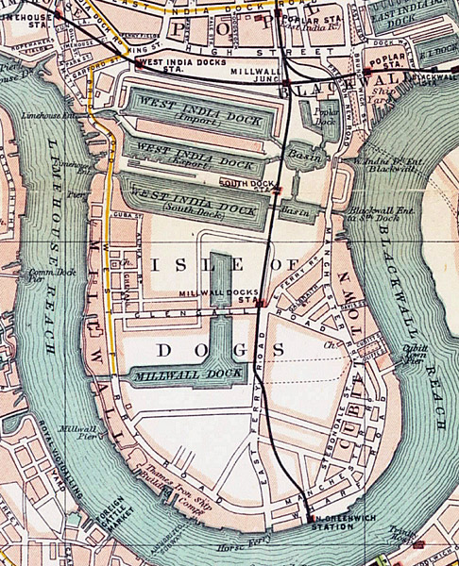
Europe
Isle of Dogs, London (1899) Public Domain
GAHTC ©2019.
Notes:
The map shows how the docks were planned. Here, the engineers used the topography of the Isle of Dogs peninsula to create one entrance and one exit. The third dock and the Millwall docks were added later. In the 19th century, all docks were interconnected and the western access to the West Indie Docks was filled in to provide better access for the increasingly important railway.
Image Source:
https://en.wikipedia.org/wiki/West_India_Docks#/media/File:Isle_of_dogs_1899.jpg

Slide 13
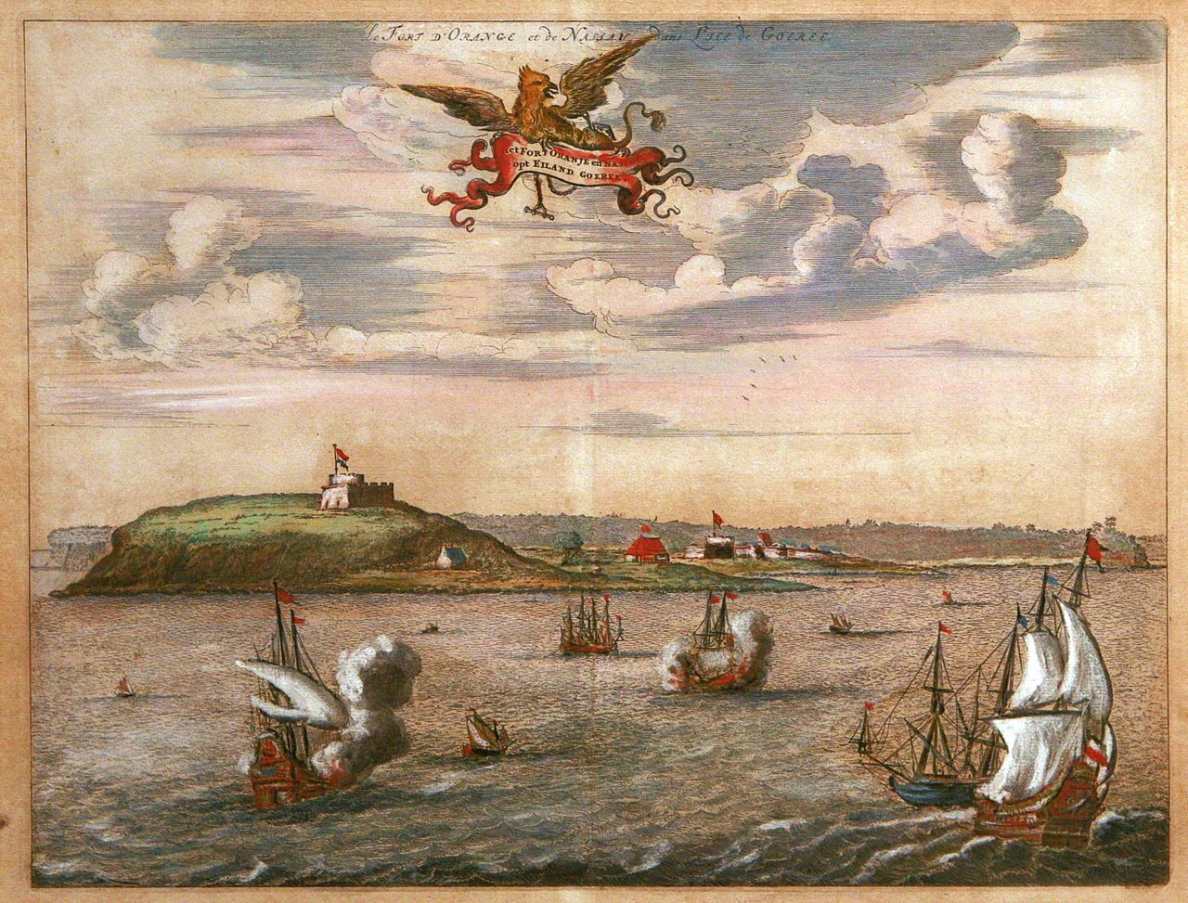
Africa
Orange and Nassau Fort at Gorée island. Coloured engraving (Holland, 17th century) Public Domain
GAHTC ©2019.
Notes:
The slave trade was mainly organised from Europe, but also from the New World. However, it was people in Africa who were robbed and enslaved in many areas. There, structures for imprisoning and shipping people were created.
Goree is a small island on the western tip of Africa off the coast of Senegal near Dakar. The island played a larger role in the transatlantic slave trade and is now a memorial to this dark chapter in history. In 1978, the island was one of the first sites to be added to the World Heritage List due to its special historical importance.
Image Source:
https://en.wikipedia.org/wiki/Gor%C3%A9e#/media/File:Le_fort_d%27Orange_et_de_Nassau_%C3%A0_l%27%C3%AEle_de_Gor%C3%A9e_mg_8503.jpg

Slide 14
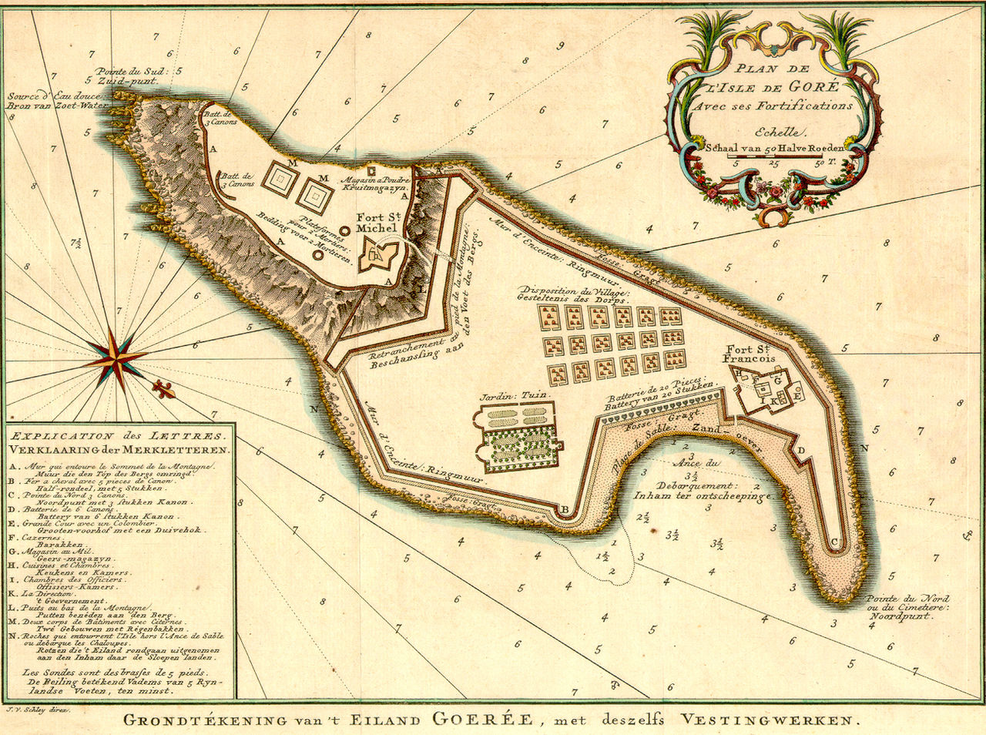
Africa
Plan of Isle de Gorée with its fortifications (1772) Public Domain
GAHTC ©2019.
Notes:
The island was bought in 1617 by the Dutch West India Company. Subsequently it changed hands frequently, between Dutch, French and English ownership. The island, secured with walls and forts, also contained a settlement. Numerous colonial buildings are still preserved today. However, the famous slave house from the end of the 18th century was not the important centre of the slave trade for which it was long considered. The bay, which was very suitable as a natural harbour, gave the island its name: Goeree, from Dutch Goede Reede - "Safe Harbour".
Image Source:
https://en.wikipedia.org/wiki/Gor%C3%A9e#/media/File:L%27Isle_de_Gore_Schley_1772.jpg

Slide 15
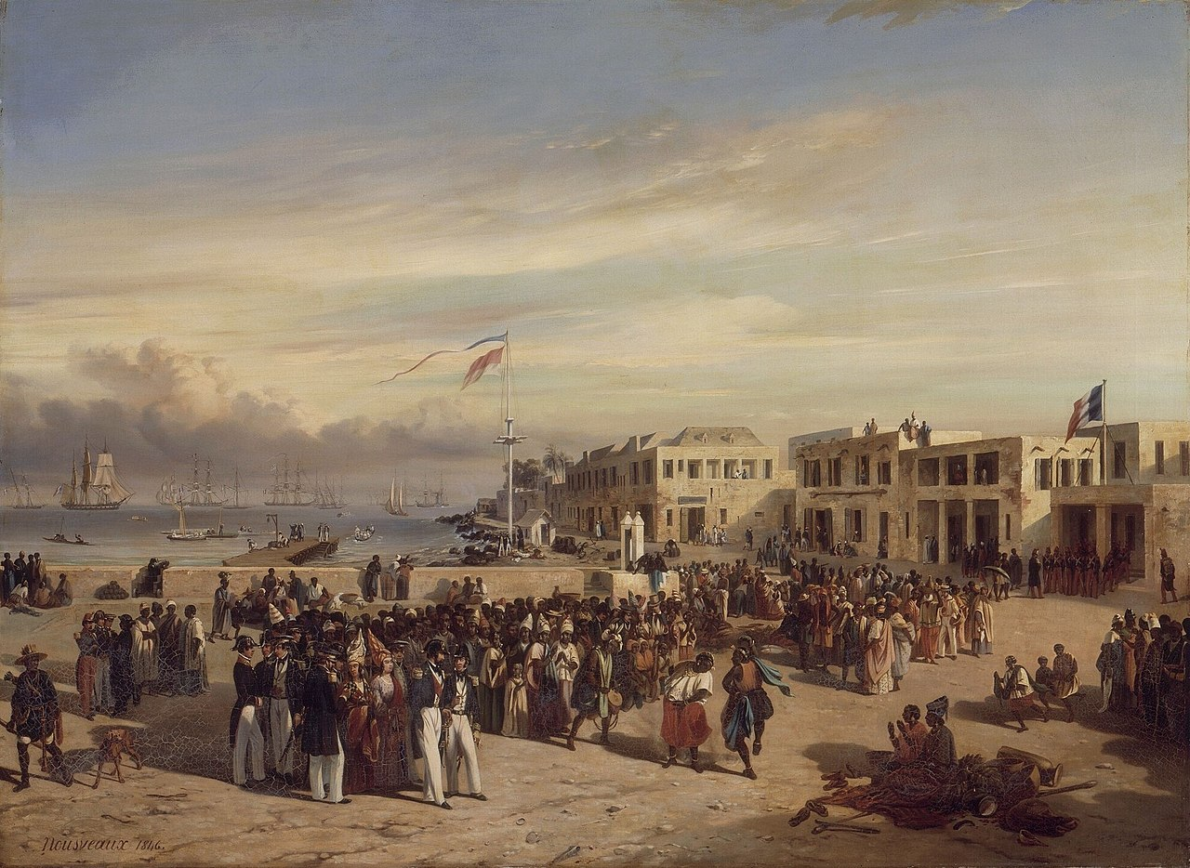
Africa
Edouard-Auguste Nousveaux: The Prince of Joinville attending a dance on Gorée Island (1842) Public Domain
GAHTC ©2019.
Notes:
The 1842 figure shows Goree in French possession as part of the Gorée et dépendances colony. The colonial buildings have numerous local architectural elements. The mooring is rather simple: a wooden pier with a primitive crane. What was sufficient for the slave trade proved to be insufficient for the loading of goods with the decline of the slave trade. With the founding of Dakar in 1857, Gorée lost importance. Goree has many contradictory architectural heritage elements from the colonial period. Slaves, servants, merchants and rulers lived in very different conditions with and next to each other on the island. To this day, the actual social conditions have not been clearly clarified.
Image Source:
https://en.wikipedia.org/wiki/Gor%C3%A9e#/media/File:Le_prince_de_Joinville_sur_l%27%C3%AEle_de_Gor%C3%A9e_en_1842.jpg_

Slide 16
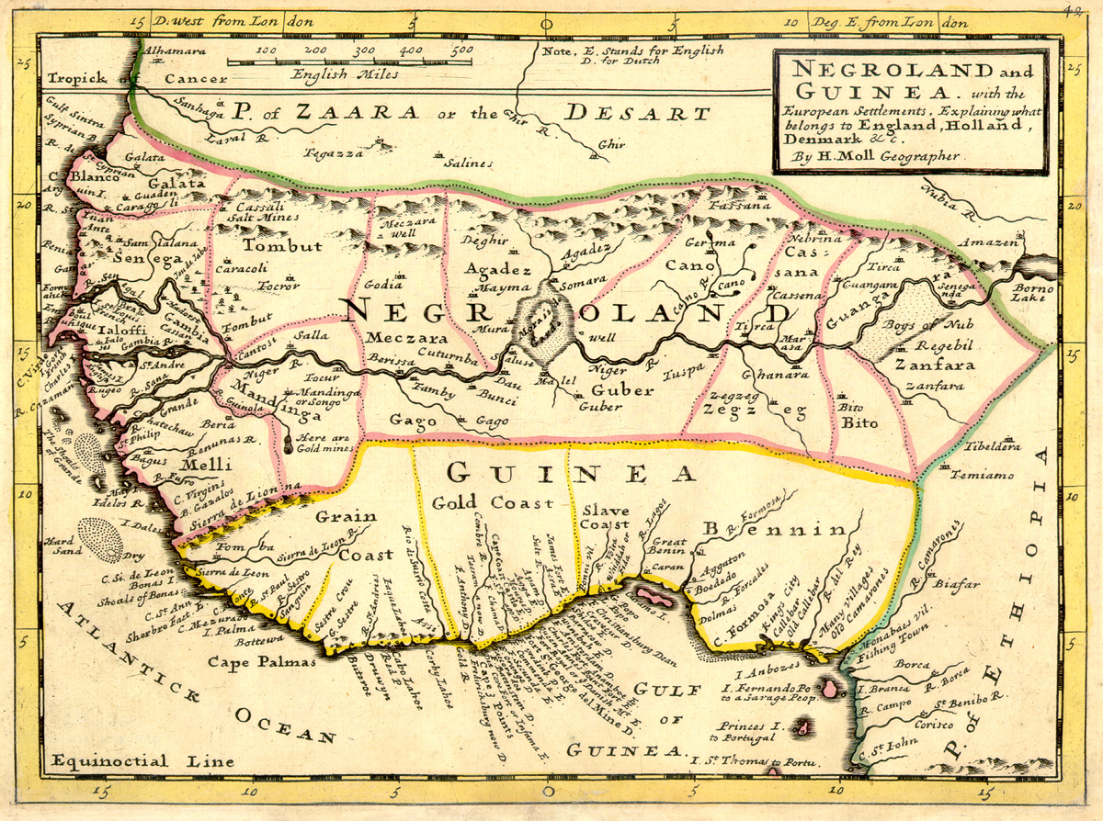
Africa
The Slave Coast (1729) Public Domain
GAHTC ©2019.
Notes:
The coast of Togo, Benin and western Nigeria used to be called the Slave Coast. There were numerous slave castles, camps and prisons where slaves were crammed together to be exported abroad. The procurement of the slaves was left to various warlike local tribes. They invaded the interior of the country to rob young men and women. These were brought on long foot marches to the slave castles.
The lower part of the West African South Coast, yellow in the map, is divided into three areas: Grain Coast, Gold Coast, Slave Coast (from left to right).
Image Source:
https://en.wikipedia.org/wiki/Slave_Coast_of_West_Africa#/media/File:Negroland_and_Guinea_with_the_European_Settlements,_1736.jpg

Slide 17
Africa
Fort Christiansborg, now Osu Castle (n.d.) Public Domain
GAHTC ©2019.
Notes:
The Christiansborg, until recently the seat of the present government of Ghana, is a castle built by Sweden in 1652. It also played a role in the slave trade. In the course of a history with various owners, the Danes were able to assert themselves from the end of the 17th century. The building became the seat of slave hunters. Soon it had to be extended by a prison, since up to 400 slaves were held captive, in order to be able to ship them into the Caribbean. The colonial castle and the settlement of the indigenous people, which consists of huts of local tradition, are noticeable side by side.
Denmark was the first slave trading nation to ban the slave trade in 1803.
Image Source:
https://en.wikipedia.org/wiki/Osu_Castle#/media/File:Christiansborg_Castle2.jpg

Slide 18
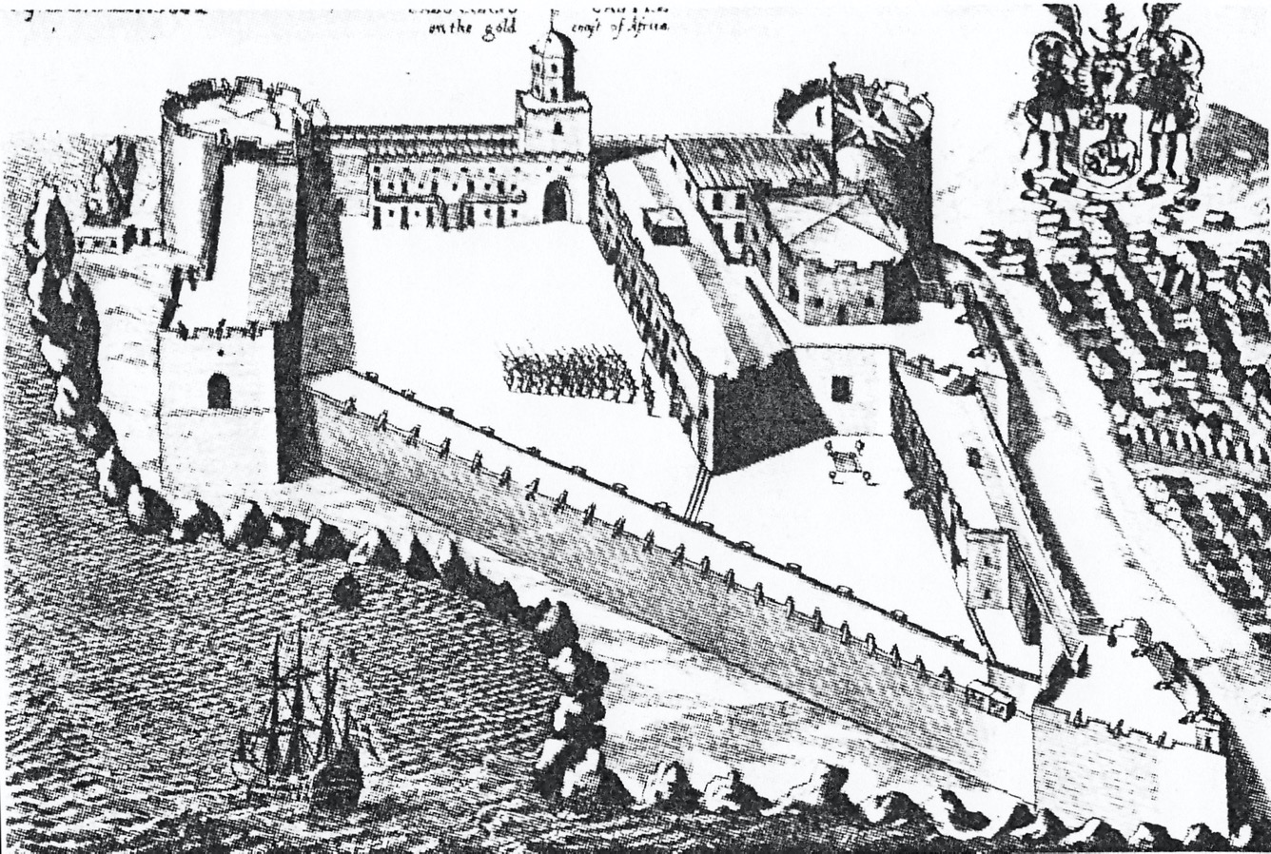
Africa
Cape Coast Castle (1682) Public Domain
GAHTC ©2019.
Notes:
Cape Coast Castle is another fortification in Ghana. Originally built by the Dutch, the castle was conquered by Sweden and used as a trading post. In 1665 the castle became British property and was finally used to ship slaves, who had to spend a long time in cellar dungeons before they were crammed into ships and sent overseas. Today the castle is a museum of the slave trade and a UNESCO world heritage site.
Image Source:
https://commons.wikimedia.org/wiki/File:CapeCoastCastle1682_300dpi_001.jpg

Slide 19
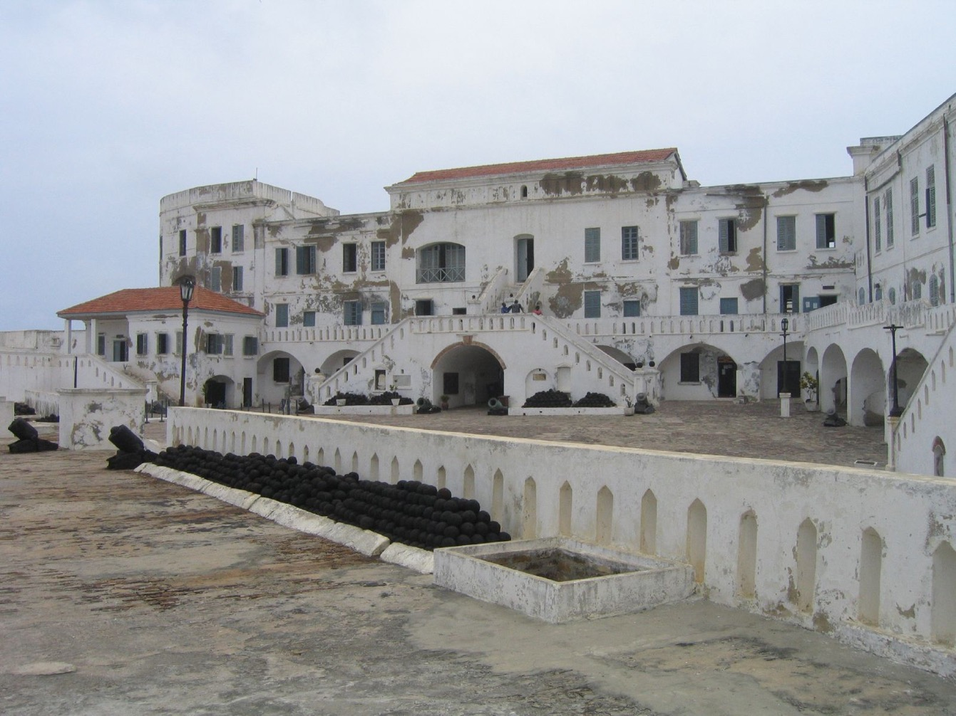
Africa
Cape Coast Castle (2004) CC BY 2.0
GAHTC ©2019.
Notes:
The white residential buildings of the merchants stand in stark contrast to the cellar dungeons below them, in which the slaves were kept.
Image Source:
https://de.wikipedia.org/wiki/Datei:Cape_Coast_Slave_Castle.jpg

Slide 20
Africa
Zanzibar Slave Market (1860) Public domain
GAHTC ©2019.
Notes:
Slave markets were a typical image of the African port cities of the slave coast. They were also common in other places, like here in Zanzibar. The slaves were exhibited examined and traded.
Physical remnants are few, but the depictions show the horrible conditions in which the slaves lived.
Image Source:
https://upload.wikimedia.org/wikipedia/commons/thumb/7/73/Zanzibar_Slave_Market%2C_1860_-_Stocqueler.JPG/1280px-Zanzibar_Slave_Market%2C_1860_-_Stocqueler.JPG

Slide 21
Africa
Greenmarket Square, Cape Town, South Africa (1764) Public domain
GAHTC ©2019.
Notes:
One of the disturbing aspects of the worldwide slave trade is the fact that it left only a few direct material traces. Most places do not show their past as a slave market or prison. Moreover, many were not used exclusively for slavery. The Greenmarket Square in Cape Town, built in 1696, served primarily as a marketplace where goods were offered. In the course of its history, however, slaves also belonged to these 'goods'. This history cannot be seen in the places and therefore requires a particularly sensitive historical consideration. In 1761 the old town house (in the background) was built, today it is one of the oldest buildings in South Africa and a silent witness of the slave trade there.
Image Source:
https://commons.wikimedia.org/wiki/File:1762_Rach_Greenmaqrket_Square.jpg

Slide 22
Americas
Shirley Plantation, Charles River, Library of Congress
GAHTC ©2019.
S
Notes:
The slave trade left its imprint on many large estates in the United States, such as the Shirley Plantation on the Charles River in Virginia. The tobacco plantations and large mansions could not have functioned without slaves.
Image Source:
URL: http://hdl.loc.gov/loc.pnp/det.4a10729

Slide 23
Americas
Cais do Valongo, Rio de Janeiro, Brazil (2012) CC BY-SA 3.0
GAHTC ©2019.
Notes:
Despite its profound impact and duration, the slave trade has left little material trace. This is particularly true for the American continent. The Cais do Valongo in the Brazilian Rio de Janeiro is one of the most important relics. It is a ship berth built between 1811 and 1817, to which the slaves were taken by small boats from the large slave ships. Today only the paving and some stairs have been preserved. The trading houses in which the slaves were offered for sale at that time, are no longer preserved. In proximity is however the largest American slave cemetery - many did not reach the new world alive.
Image Source:
https://commons.wikimedia.org/wiki/File:Cais_do_Valongo_e_da_Imperatriz.jpg

Slide 24
Americas
Slave Huts, Bonaire, Netherlands (2007) CC BY-SA 1.0
GAHTC ©2019.
Notes:
These huts also belong to the inconspicuous material relics of the slave trade. They were built on Bonaire in 1850 during the slavery period and served as a camp for slaves who worked in the salt ponds. Salt was one of Bonaire's most important commodities. The small windowless huts served as dormitories and storage places for the personal belongings of the working team. The huts were seven hours' walk from the slaves' home in Rincon, where they could retreat on weekends.
Image Source:
https://de.wikipedia.org/wiki/Datei:Bonaire_Red_Slave_Huts.jpg

Slide 25
Americas
Faneuil Hall, Boston, USA (1903) Public domain
GAHTC ©2019.
Notes:
Built as a market and meeting hall, Faneuil Hall was a gift from slave trader Peter Faneuil to the city of Boston. Opened in 1743, the building is reminiscent of an English country market and still serves as a marketplace. It is controversial that it was financed by the slave trade and bears the name of a slave trader. An initiative to change the name was not granted. Many other places and buildings are directly or indirectly connected with the slave trade and shape the built environment of port cities without explicitly revealing their history.
Image Source:
https://nl.m.wikipedia.org/wiki/Bestand:Faneuil_Hall_LOC_4a30408u.jpg

Slide 26
Americas
Slave Market, Louisville, USA (1934) Public domain
GAHTC ©2019.
Notes:
Other buildings, such as the slave market in Louisville, are rather inconspicuous, but give clearer indications of their original function - as has happened here through information boards. But also by the slave market in Louisville it becomes clear that the inhumane history of the slave trade can hardly be recognized without further clues.
Image Source:
https://commons.wikimedia.org/wiki/File:Slave_Market,_Public_Square,_Louisville_(Jefferson_County,_Georgia).jpg

Slide 27
Slave memorial Zanzibar, Tanzania (2009) CC BY 2.0
GAHTC ©2019.
Notes:
The dark chapter of the slave trade has made many port cities and local traders rich. The material traces are rarely obvious. They are rather to be seen in the buildings and infrastructures that were realized with the help of exploitation. In most places there is a lack of clear indications and also of conflict with this difficult heritage.
The Black Lives Matter movement has shone a light on the need for advanced discussion of these historic injustices.
Image Source:
https://commons.wikimedia.org/wiki/File:Slave_memorial_Zanzibar.jpg

Slide 28
Literature
James A. Rawley, Stephen D. Behrendt.
The Transatlantic Slave Trade: A History.
University of Nebraska Press, 2005.
Hugh Thomas.
The Slave Trade.
Hachette, 2015.
Holger Weiss.
Ports of Globalisation, Places of Creolisation: Nordic Possessions in the Atlantic World During the Era of the Slave Trade.
Boston: Brill, 2016.
Randy J. Sparks.
Where the Negroes Are Masters: An African Port in the Era of the Slave Trade. Cambridge, Massachusetts: Harvard University Press, 2014.
Mariana P. Candido.
An African Slaving Port and the Atlantic World: Benguela and Its Hinterland.
Cambridge University Press, 2015.
GAHTC ©2019.
Notes:
Here is a selection of references.

